Slide 1

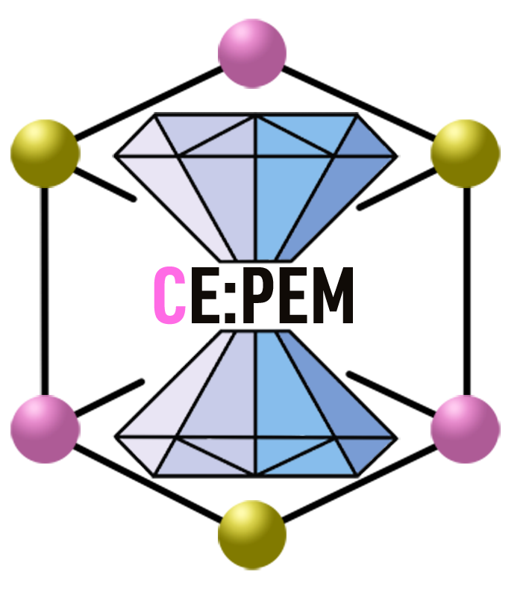
Research Experience in First-Principles Study of Quantum Materials — An Academic Research Journey
Dr. Prutthipong Tsuppayakorn-aek
Division of Physics, Faculty of Science and Technology, Princess of Naradhiwas University

Slide 2



Introduction
Education
Chulalongkorn University: Ph.D. in Physics
Chulalongkorn University: M.Sc. in Physics
Prince of Songkla University: B.Sc in Ed (Physics)
Experience
Visiting researcher at Uppsala University, Sweden
Postdoc, Ratchadapiseksomphot Research Funds, CU,
Trainee teacher, Satit PSU

Slide 3
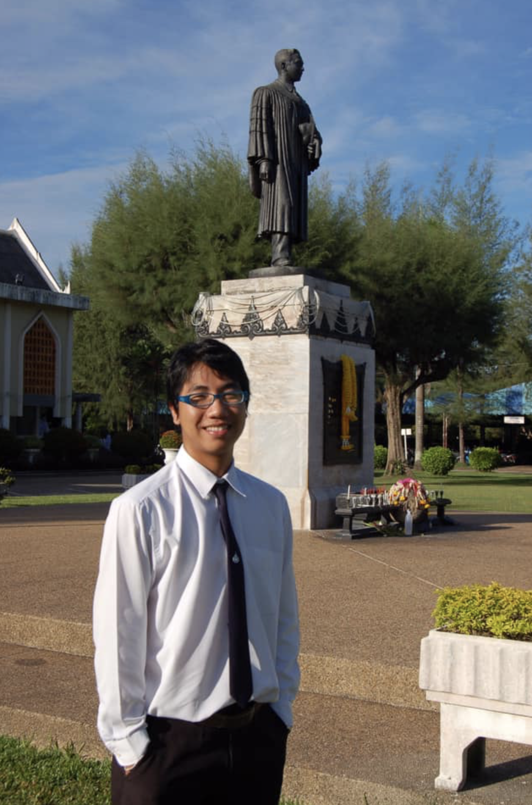
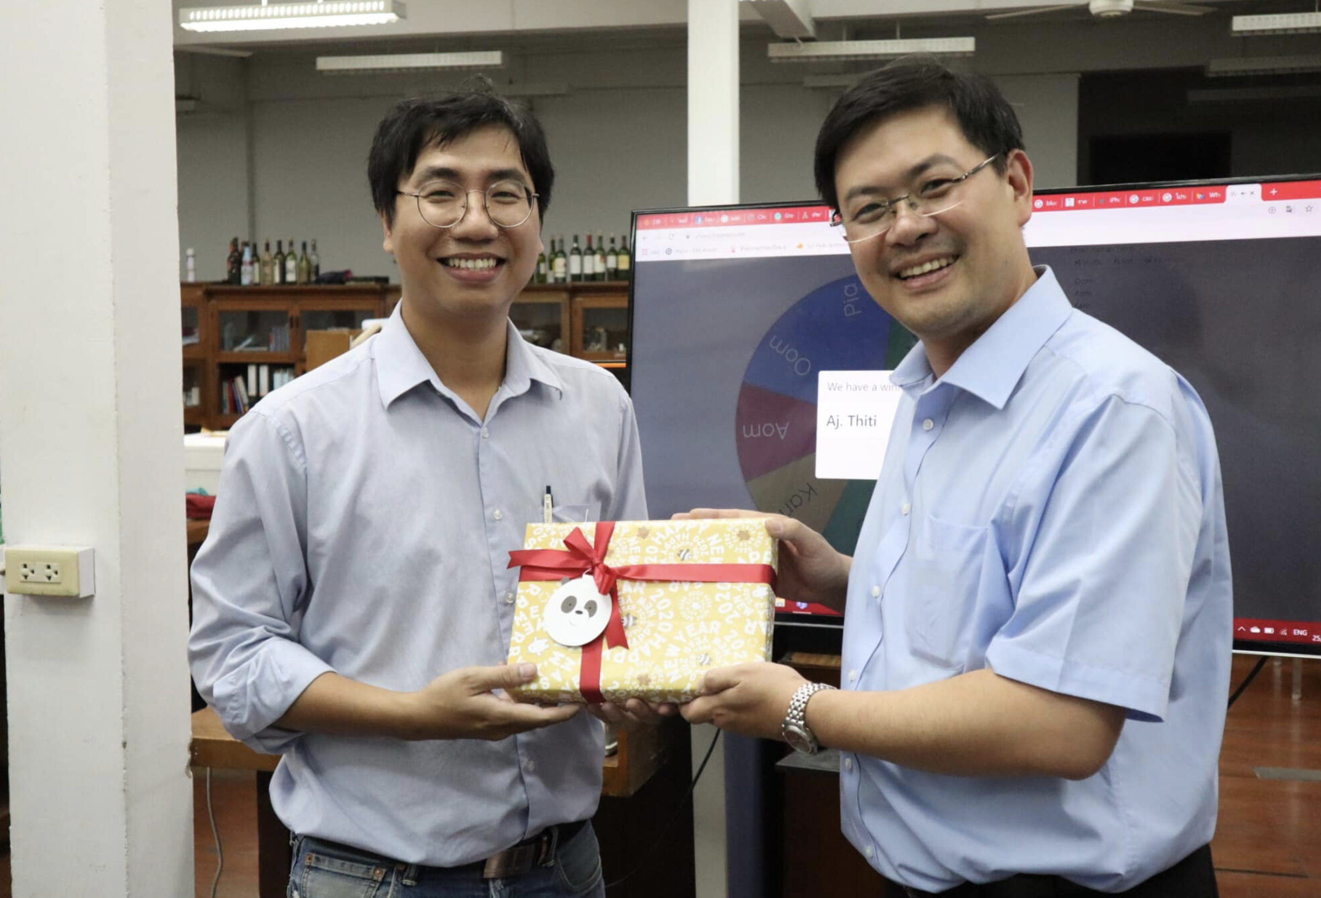
A Defining Encounter — The Mentor Who Shaped My Academic Path

Slide 4
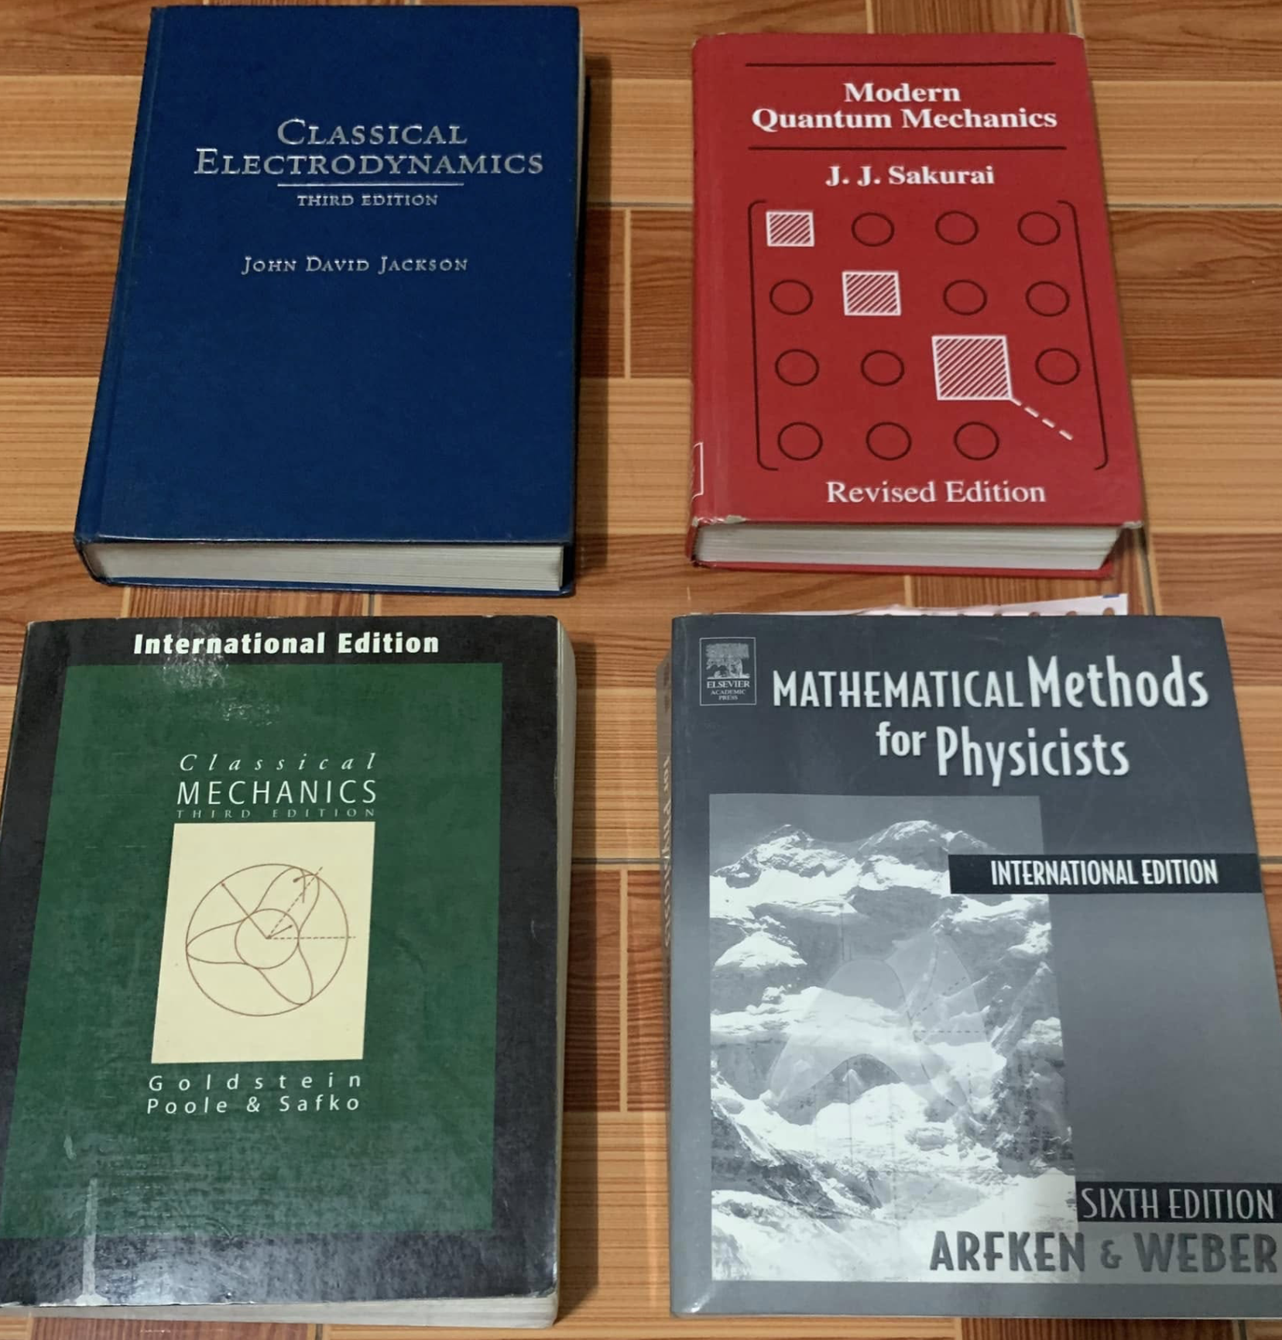
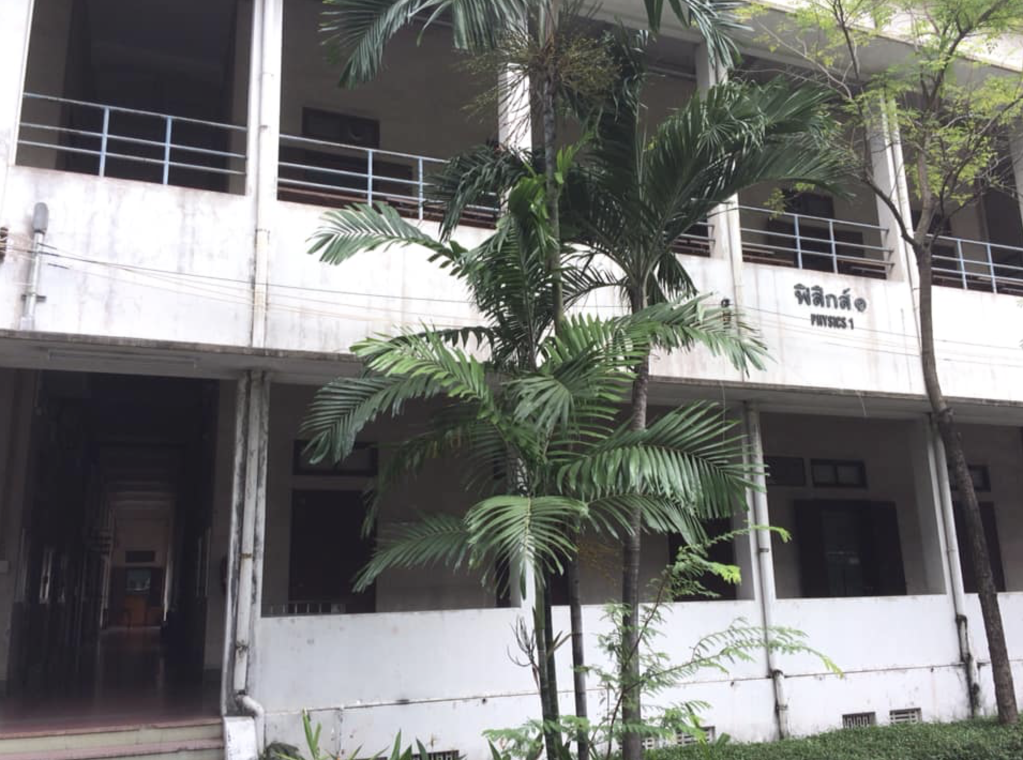
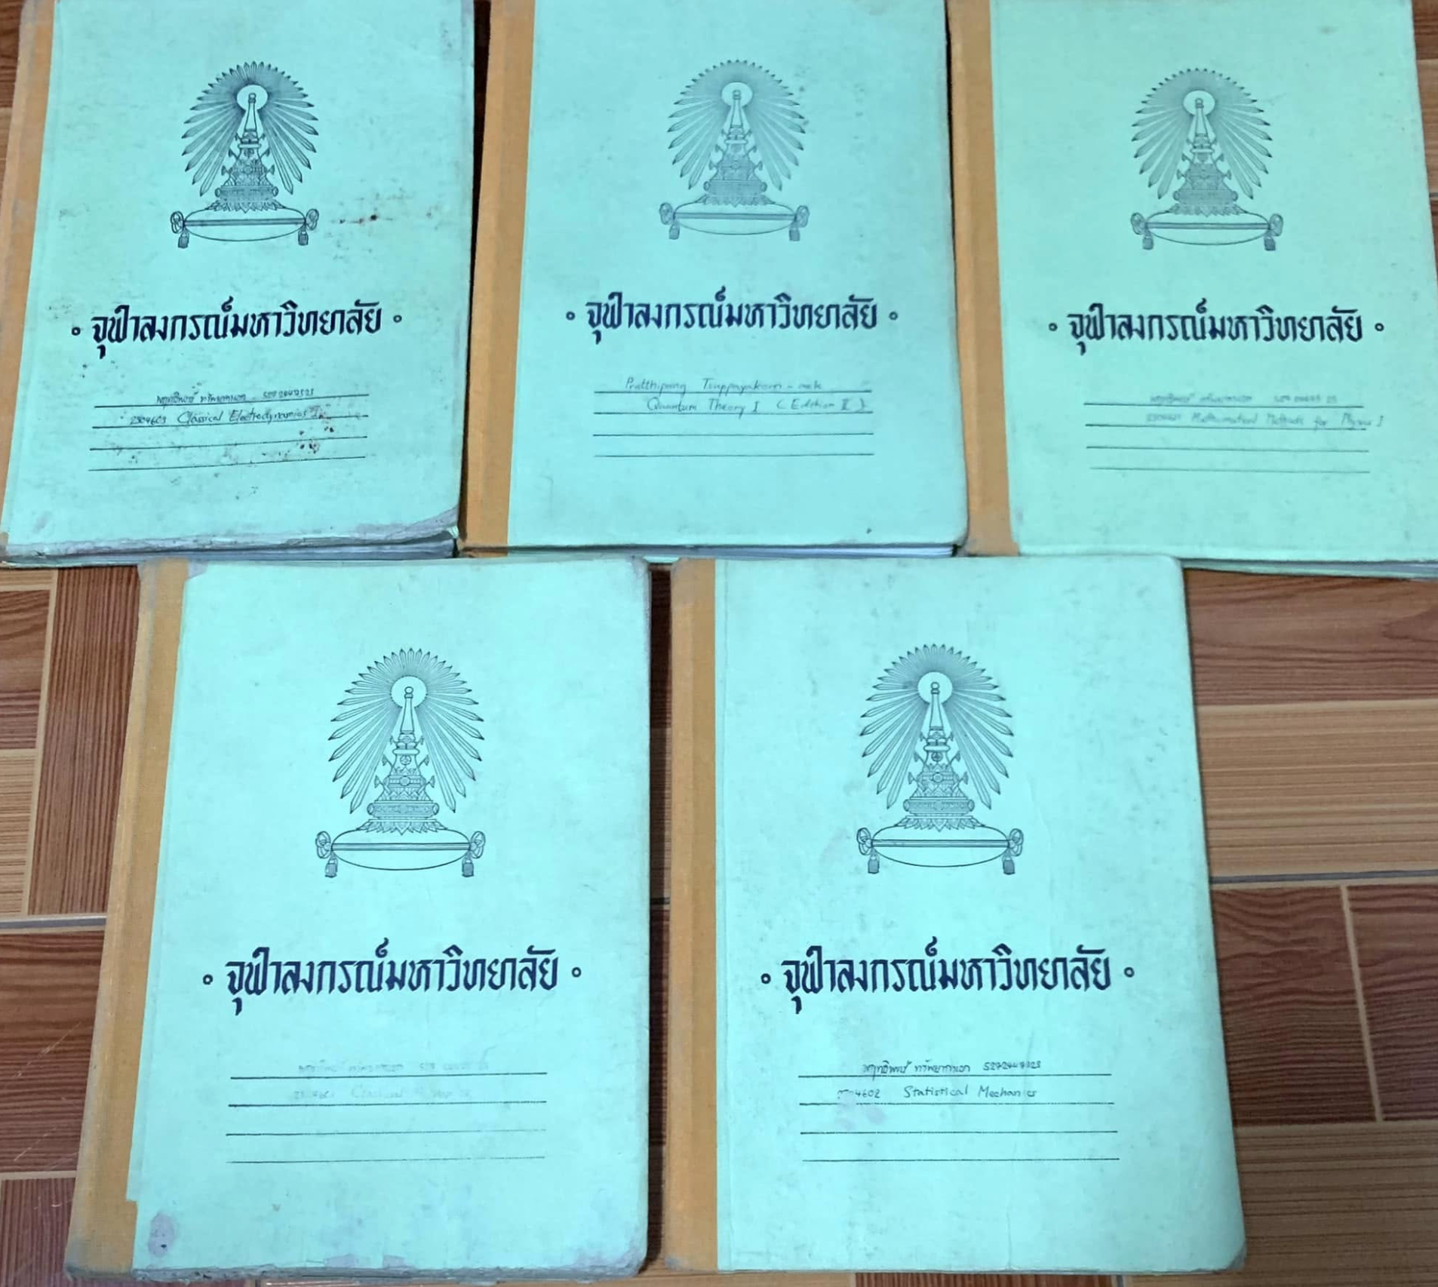

Slide 5
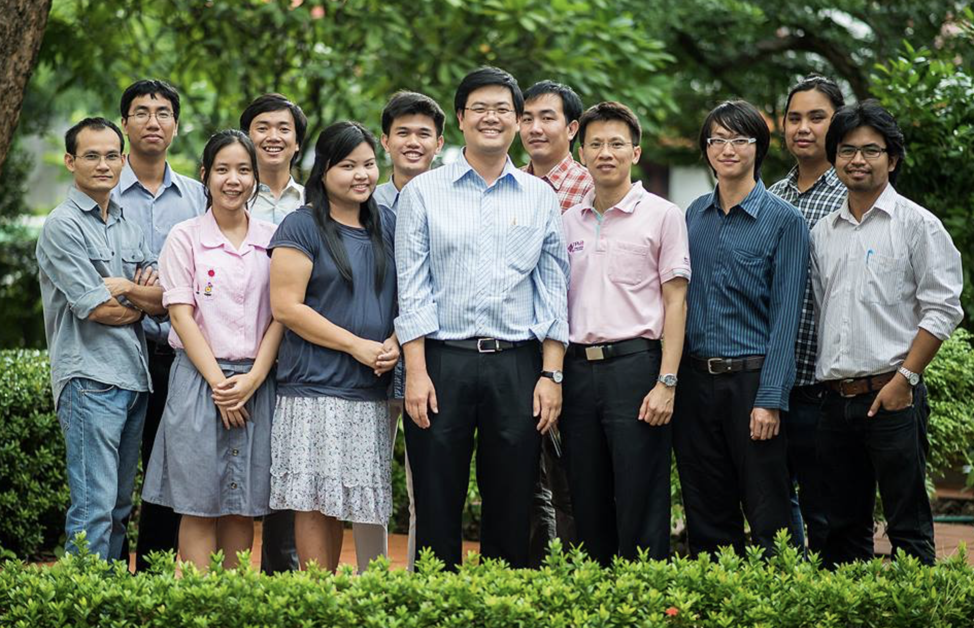
Extreme Conditions Physics Research Laboratory (ECPRL)

Slide 6
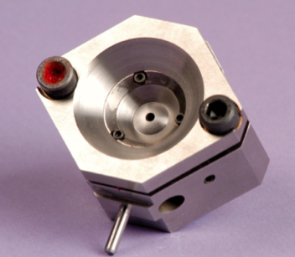
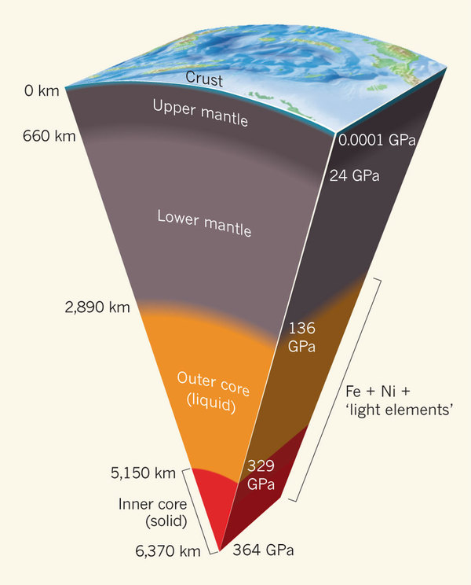
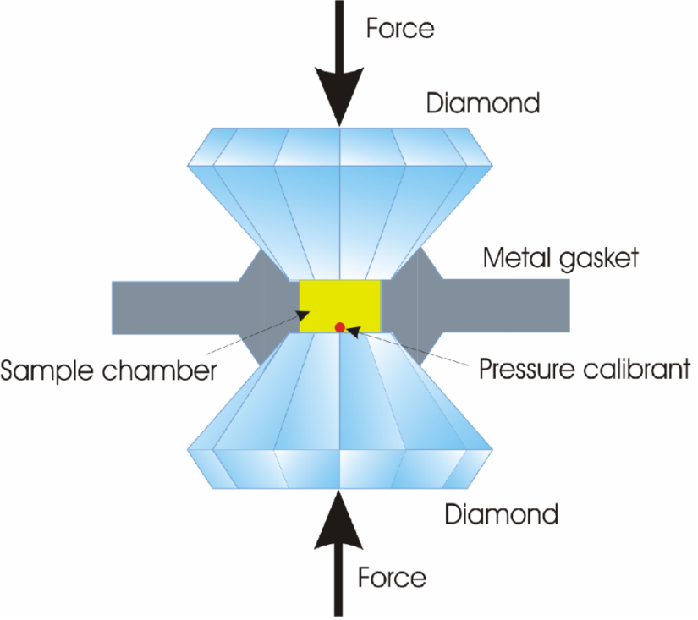
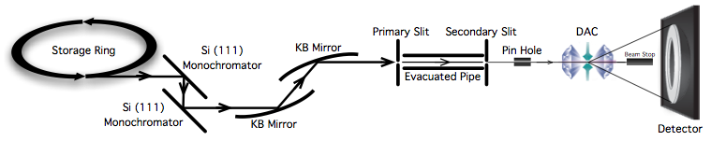
Extreme Conditions Physics
THOMAS S. DUFFY, 2011
W. Chaimayo 2012
Notes:
Studying materials at Gigapascal (GPa) pressures will provide insights into the deep interiors of large planets and chemistry under extreme conditions Understanding and explaining the structural phase transformation are represented in the level of pressure. It is corresponding to the Earth’s inner core
In order to get the extreme condition physics, the diamond anvil cell used to mimic the level of pressure in the Earth’s inner core. Namely the earth’s inner Core equal to diamond anvil cell (DAC)

Slide 7
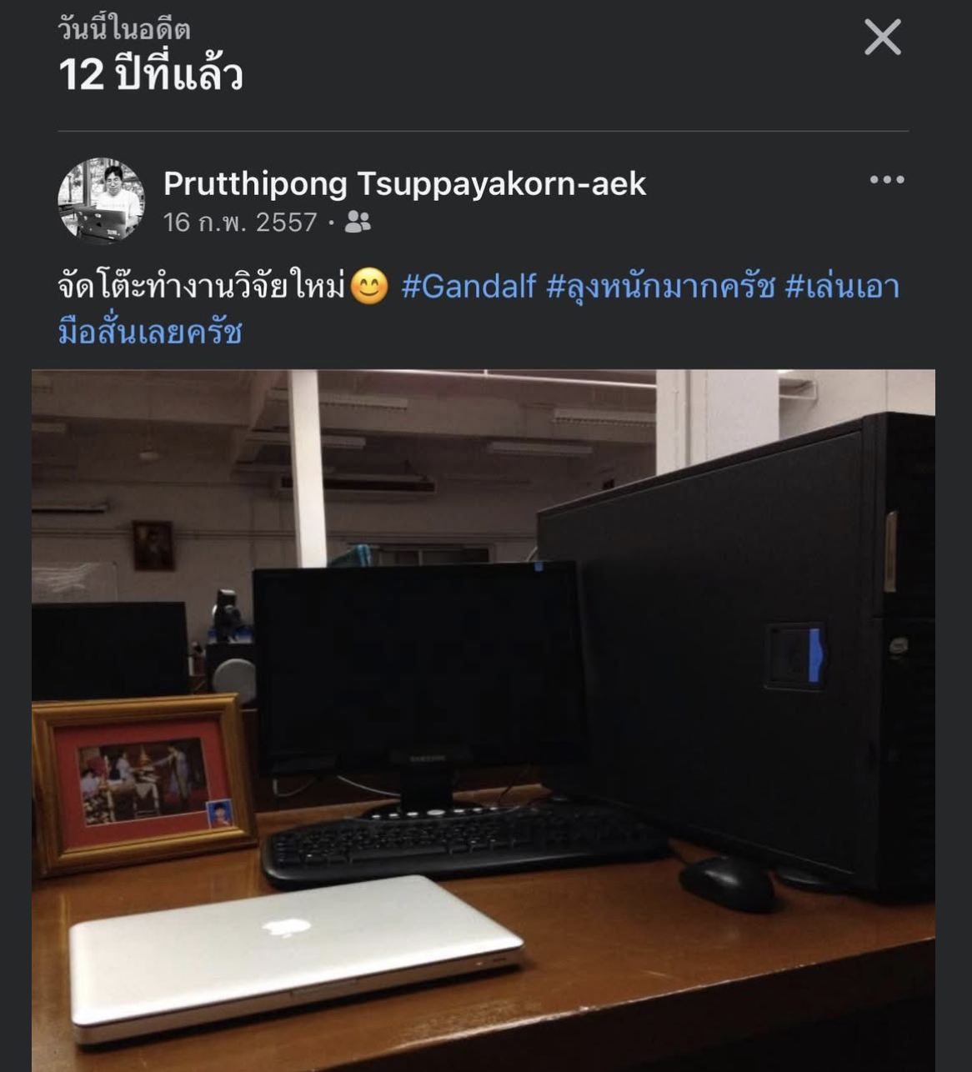

Slide 8

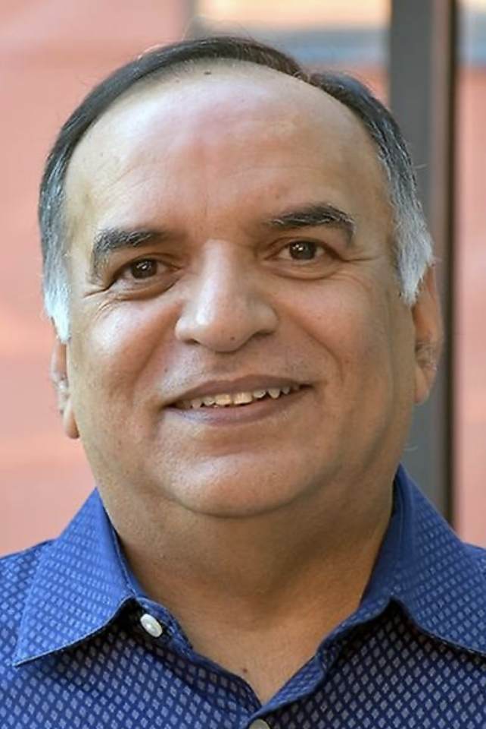
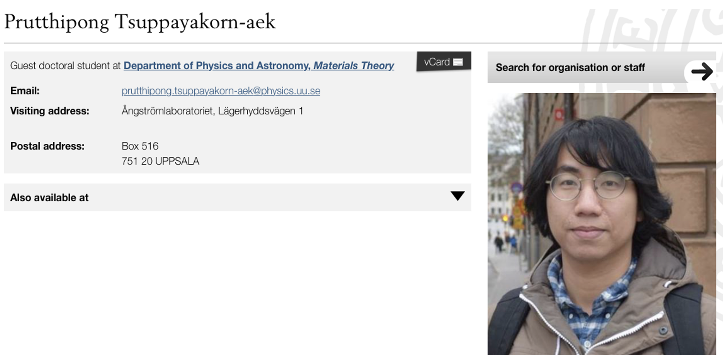
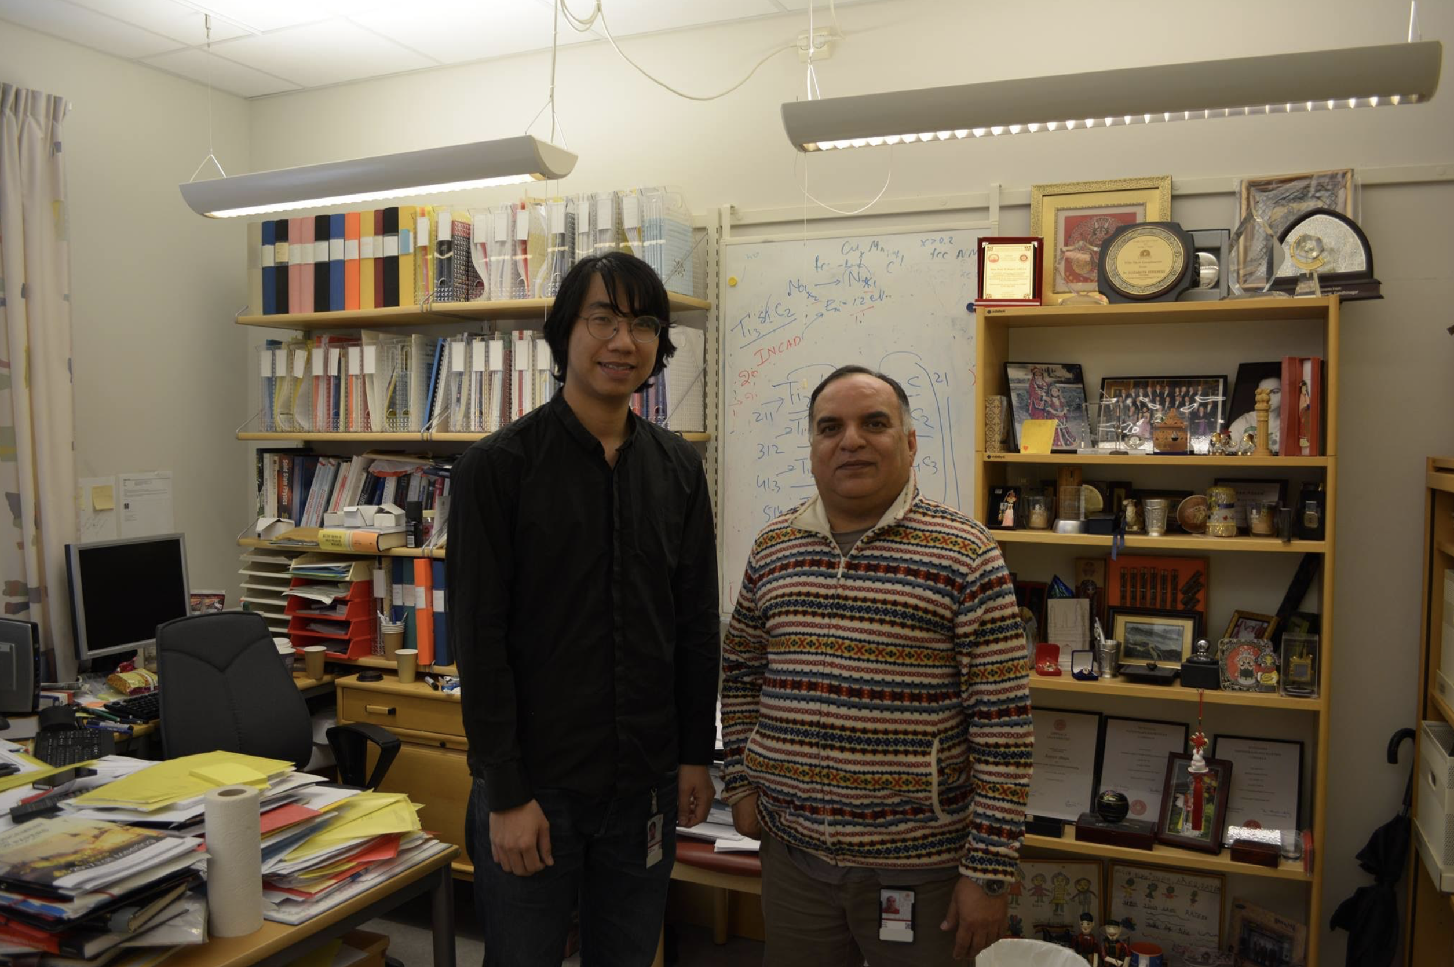
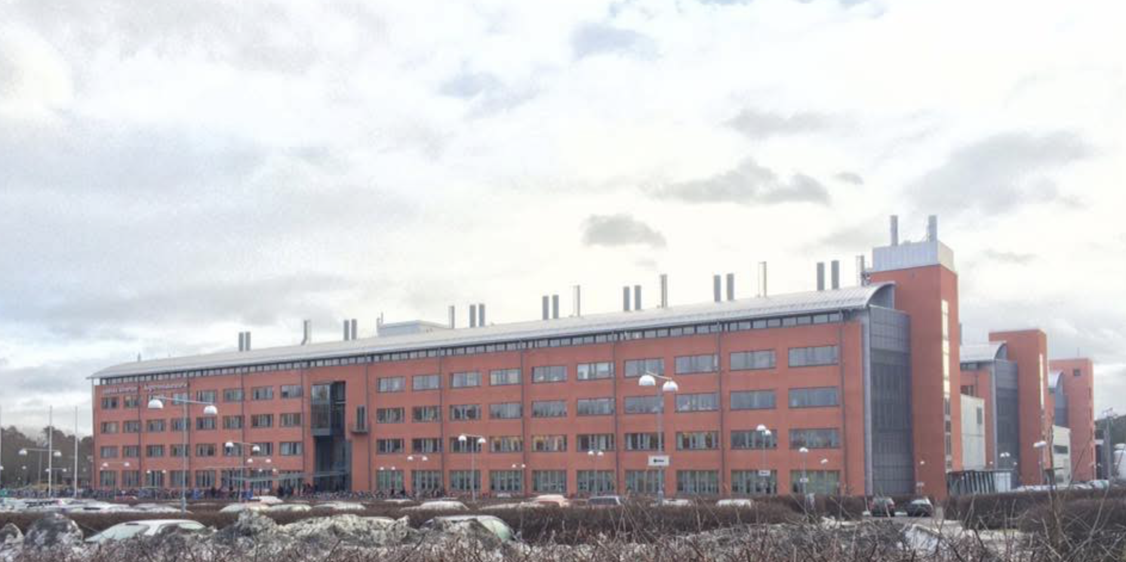

Slide 9
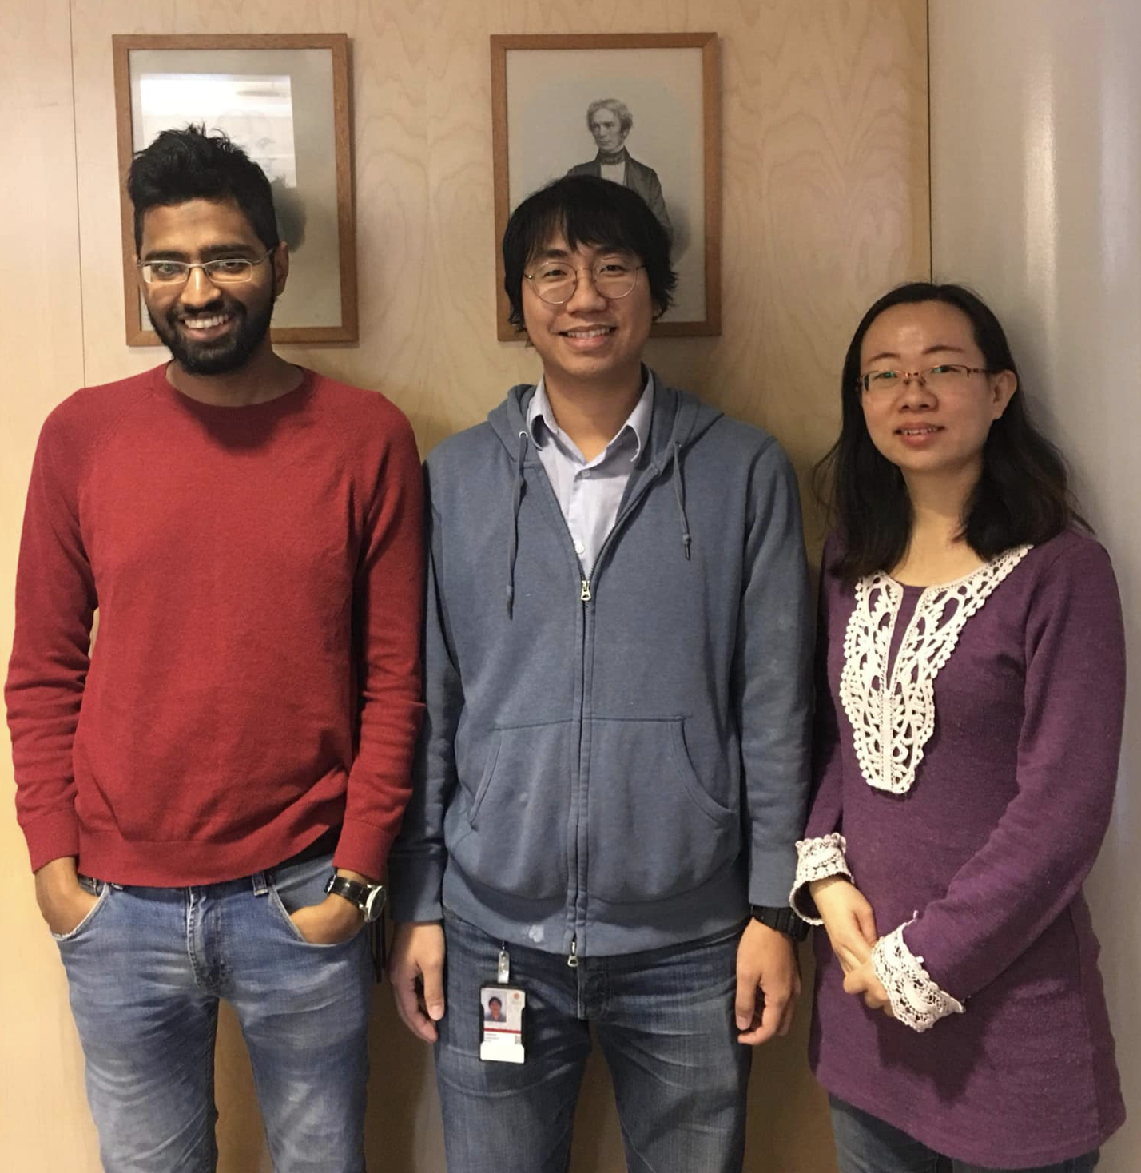
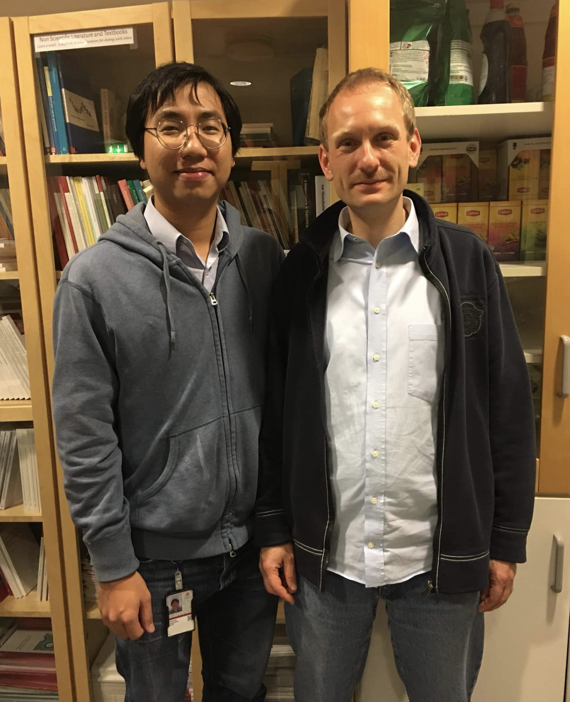
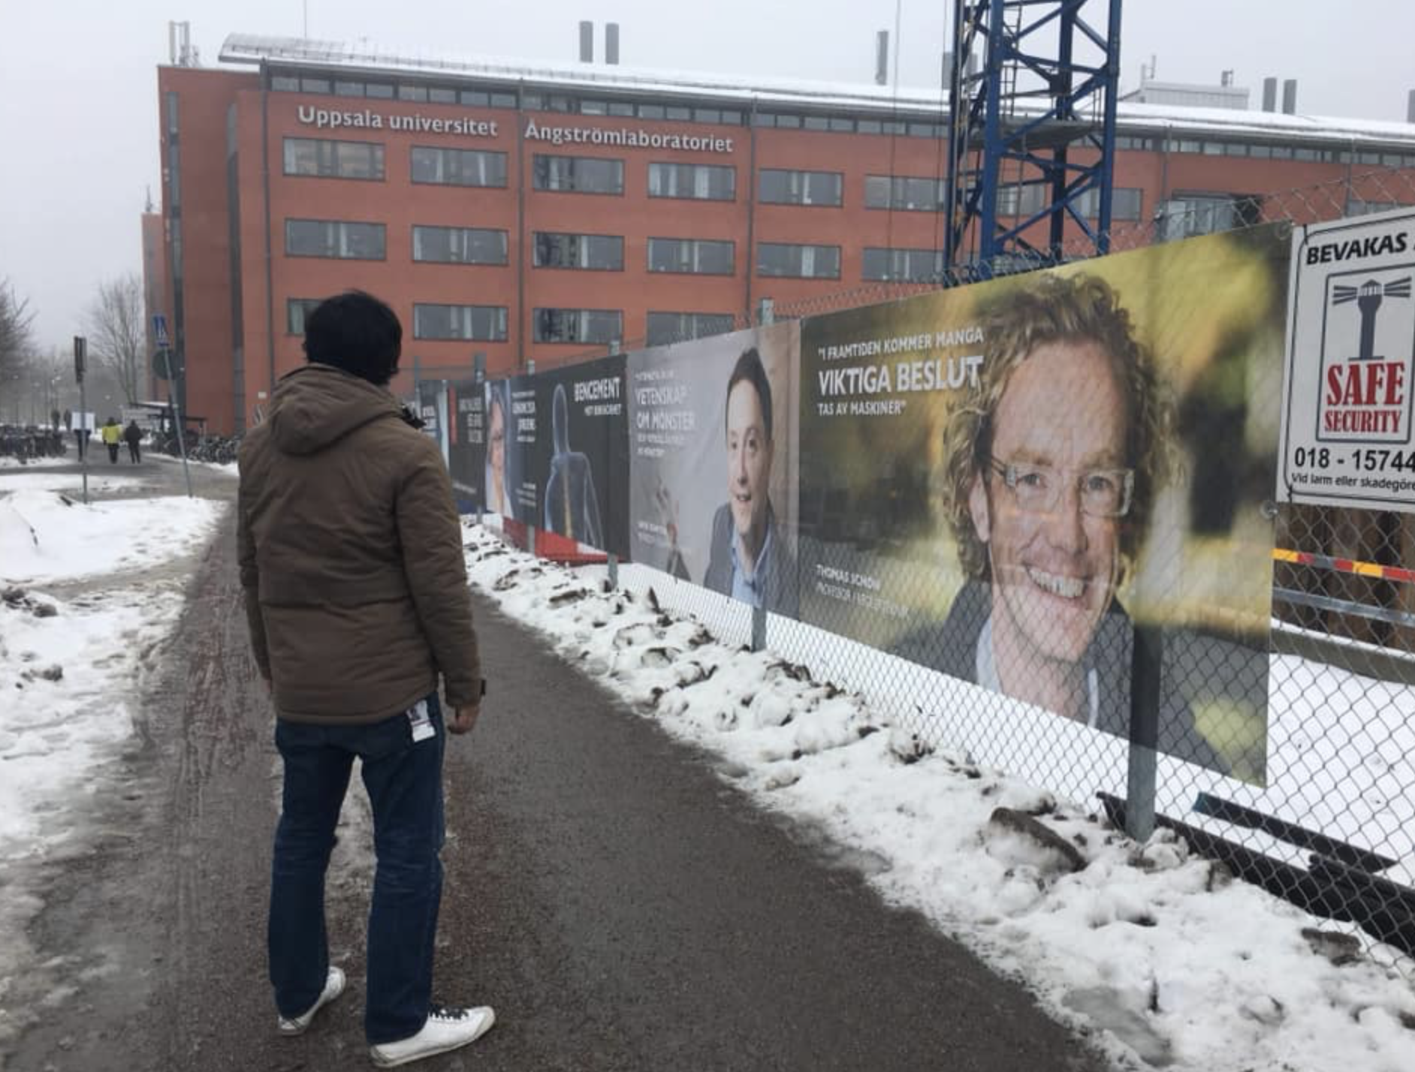
Goodbye Uppsala

Slide 10
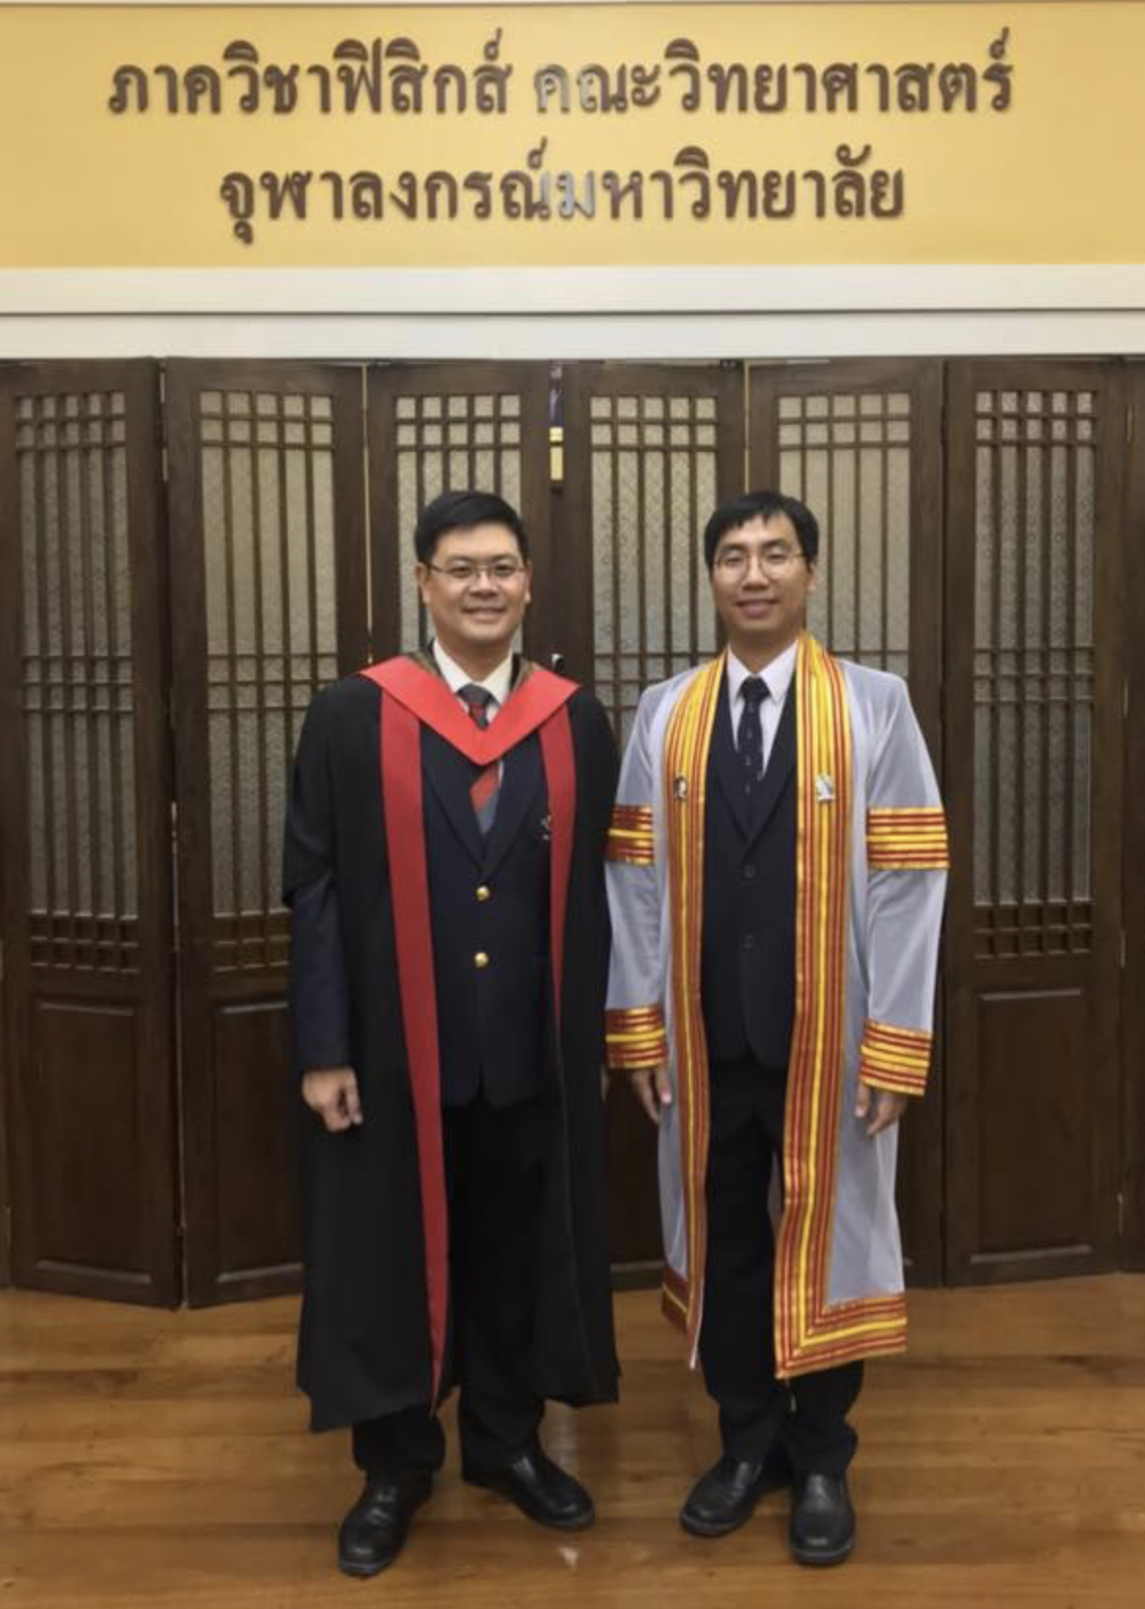
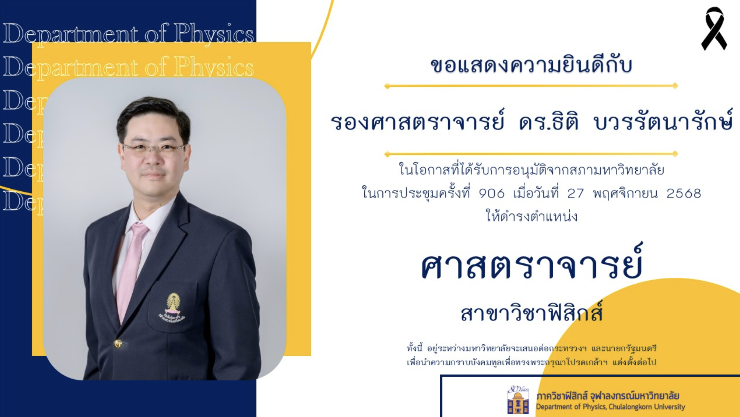
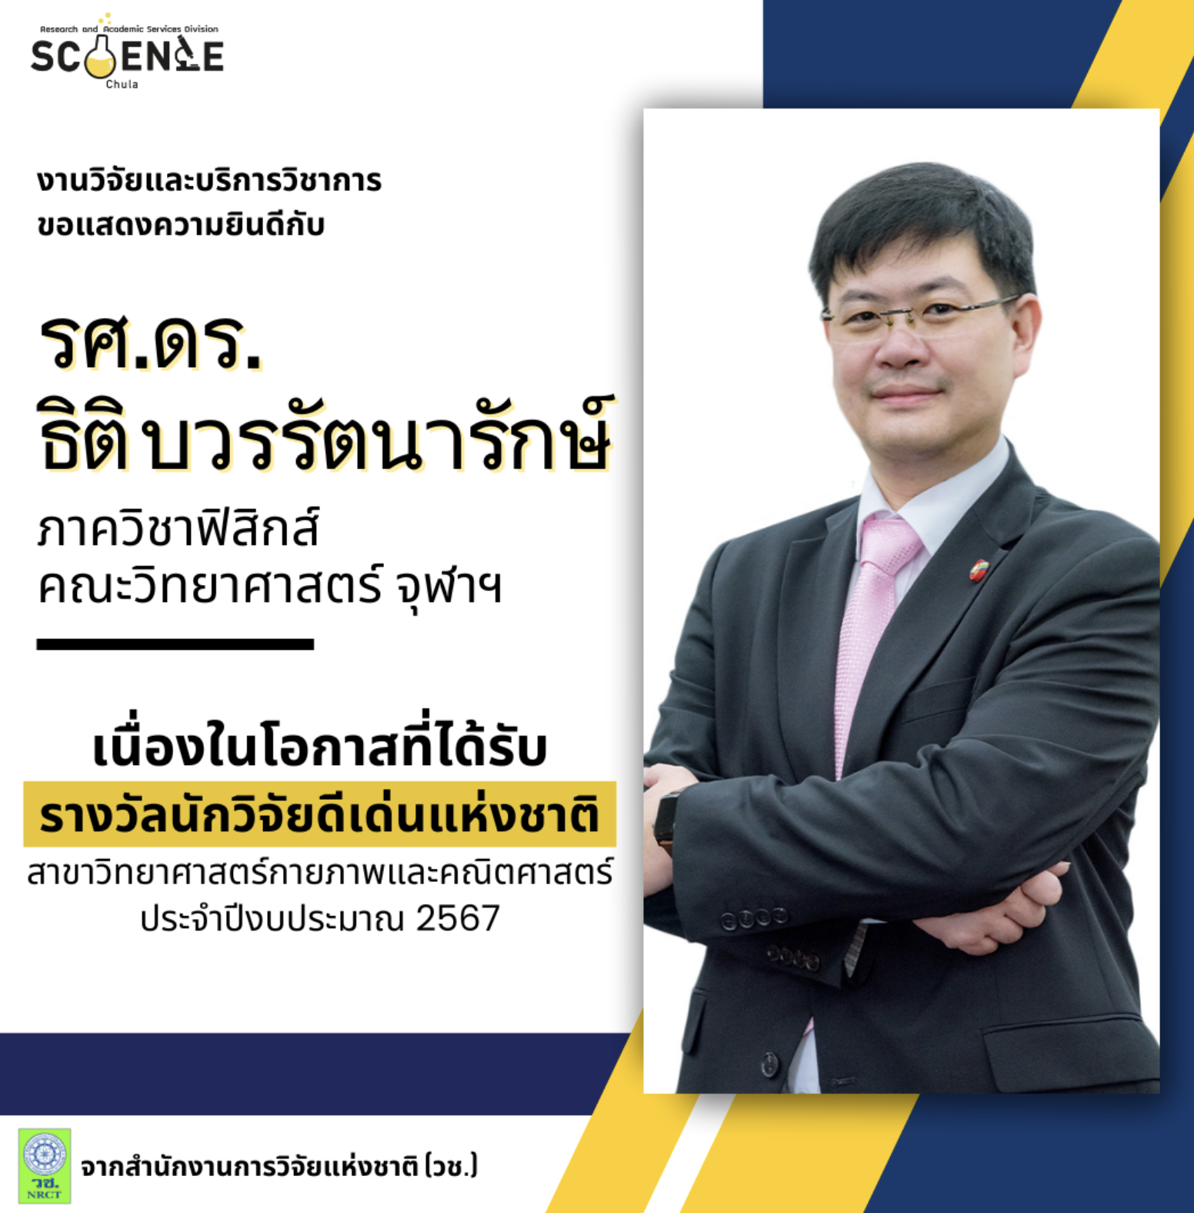

Slide 11
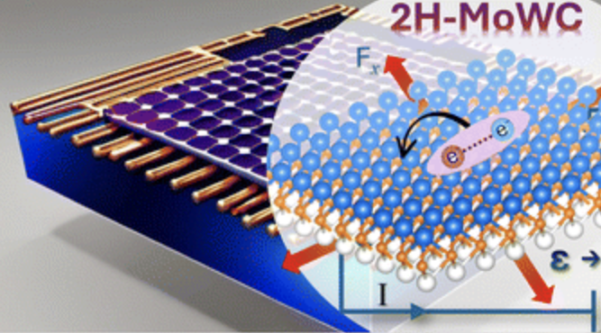
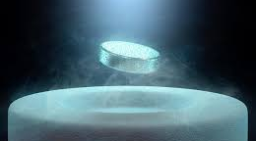
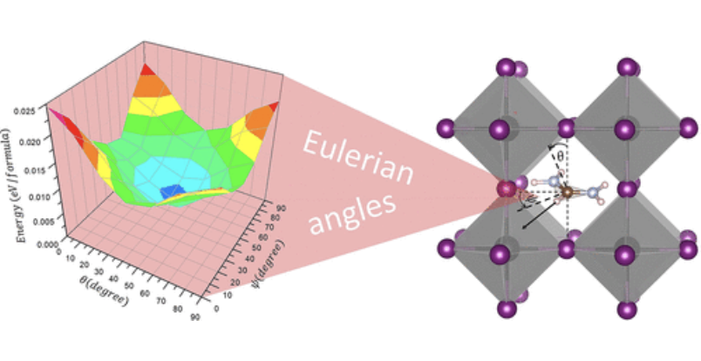
Research
My focus is on the fields of physics and materials science, particularly studying the properties of materials under extreme conditions such as high pressure.
Research Focus:
High pressure condensed-matter physics.
Superconductivity.
Hydrogen storage.
Perovskite solar cells.
2D-materials.
Research Contributions:
Contributed to understanding how electronic structures and stability of materials are influenced by conditions such as high pressure.
Work involves advanced computational methods like Density Functional Theory (DFT) to predict and analyze material behaviors.
https://physicsworld.com/a/have-scientists-in-korea-discovered-the-first-room-temperature-ambient-pressure-superconductor/

Slide 12

Research sorfware
Lattice dynamics
Stochastic self-consistent harmonic approximation (SSCHA)
Temperature Dependent Effective Potentials (TDEP)
PHONOPY
Crystal Orbital Hamiltonian Population (COHP)
Alloy-Theoretic Automated Tool kit (ATAT)
First-priciples calculations
Cambridge Serial Total Energy Package (CASTEP)
Vienna Ab initio Simulation Package (VASP)
Quantum Espresso (QE)
Structural prediction
AIRSS (Ab Initio Random Structure Searching)
Universal Structure Predictor: Evolutionary Xtallography (USPEX)
Crystal structure AnaLYsis by Particle Swarm Optimization (CALYPSO)
Alloy-Theoretic Automated Tool kit (ATAT)
Chemical bonding
Crystal Orbital Hamiltonian Population (COHP)
Tetralith
Tetralith is NSC's largest HPC cluster (Sweden).
Tetralith consists of 1908 compute nodes each with two Intel Xeon
Gold 6130 cpus with 16 CPU cores each, giving a total of 61056 CPU cores.
https://www.nsc.liu.se/systems/tetralith/

Slide 13
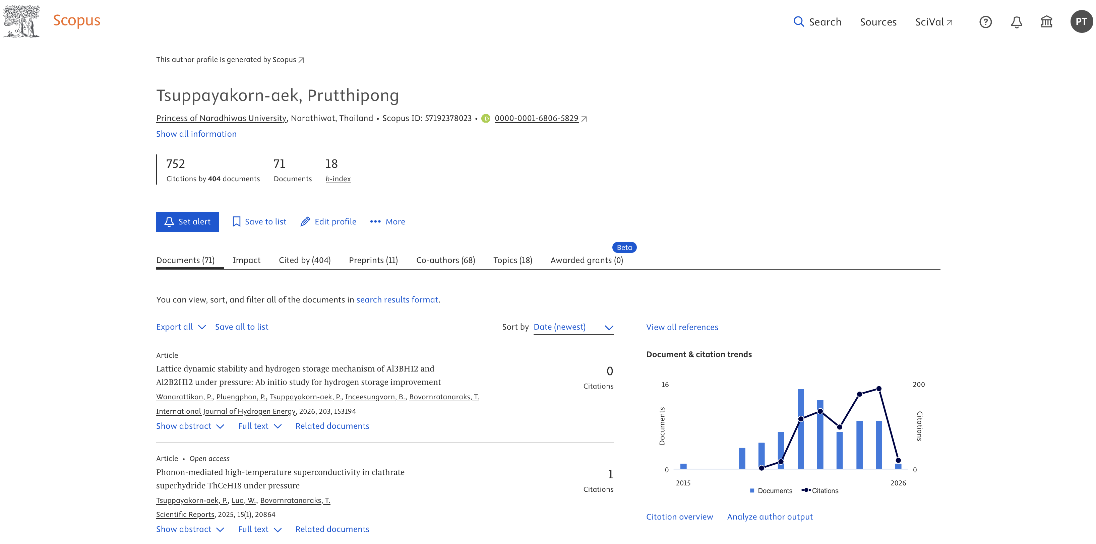
Gap years

Slide 14
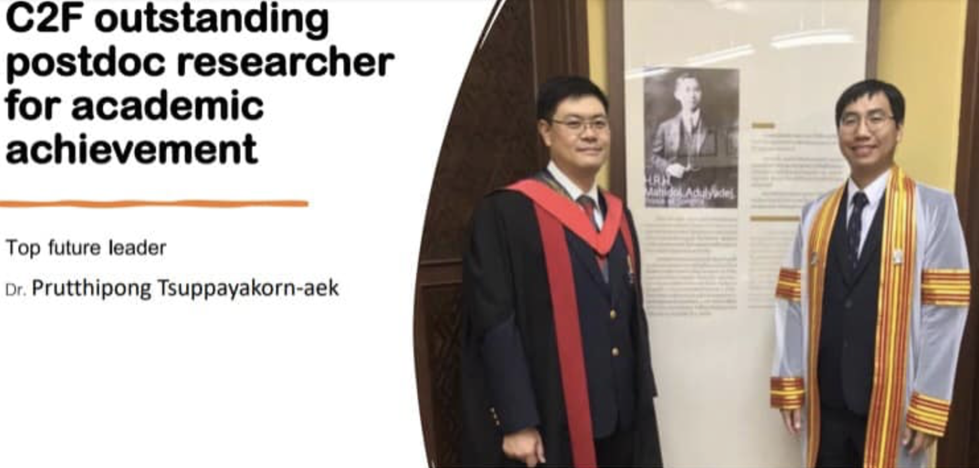

Slide 15
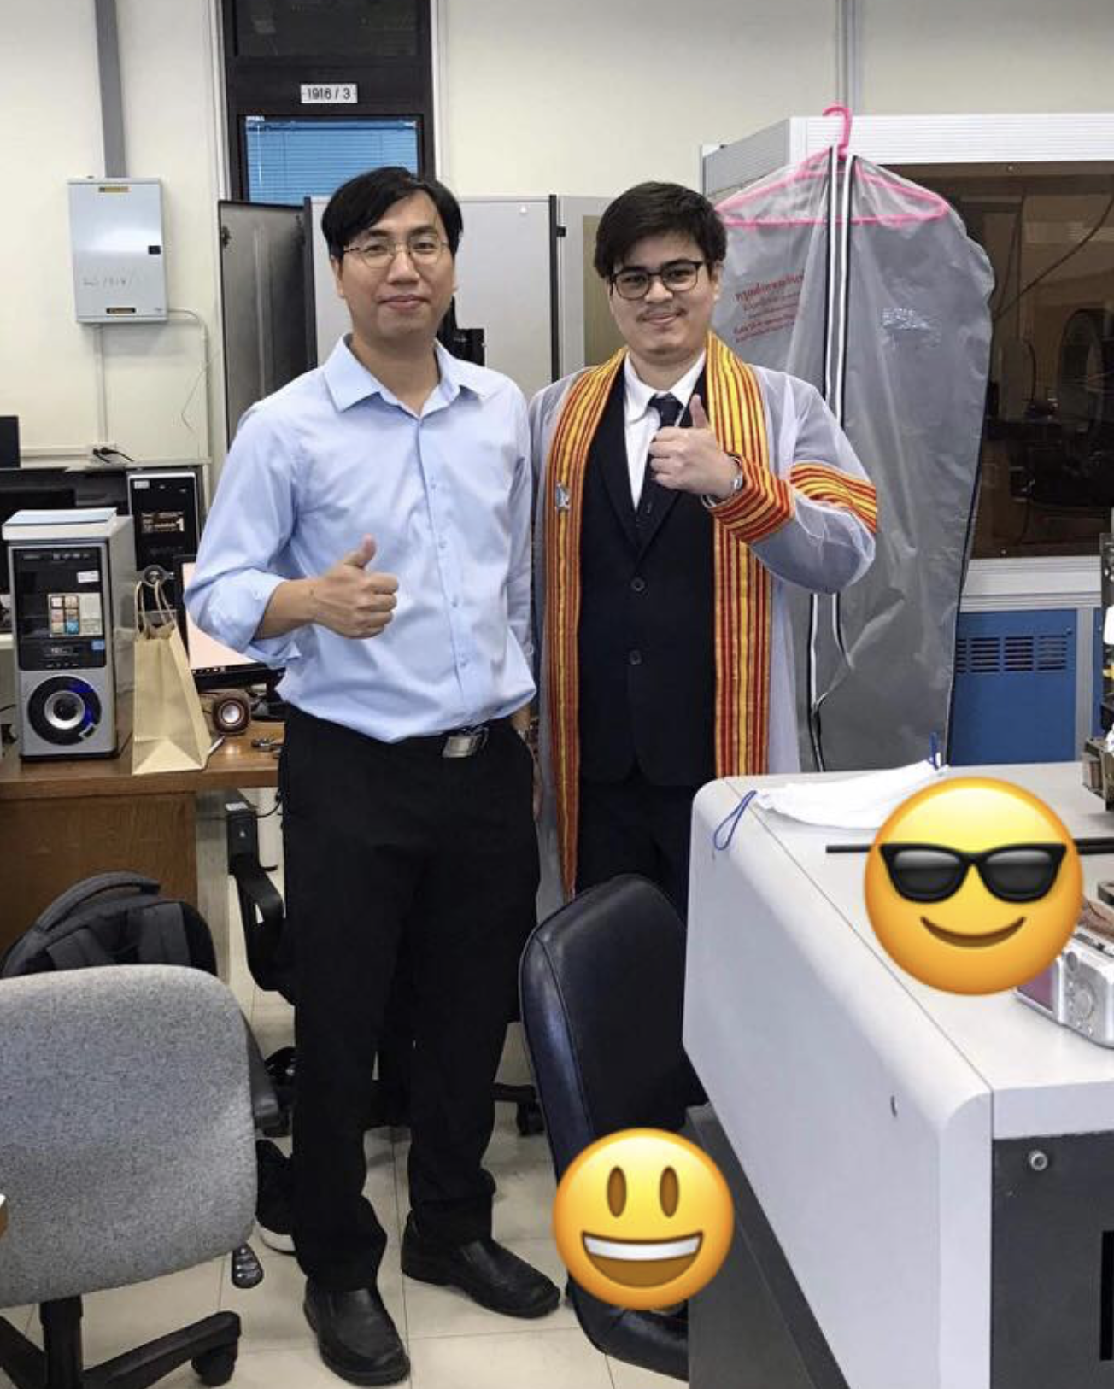
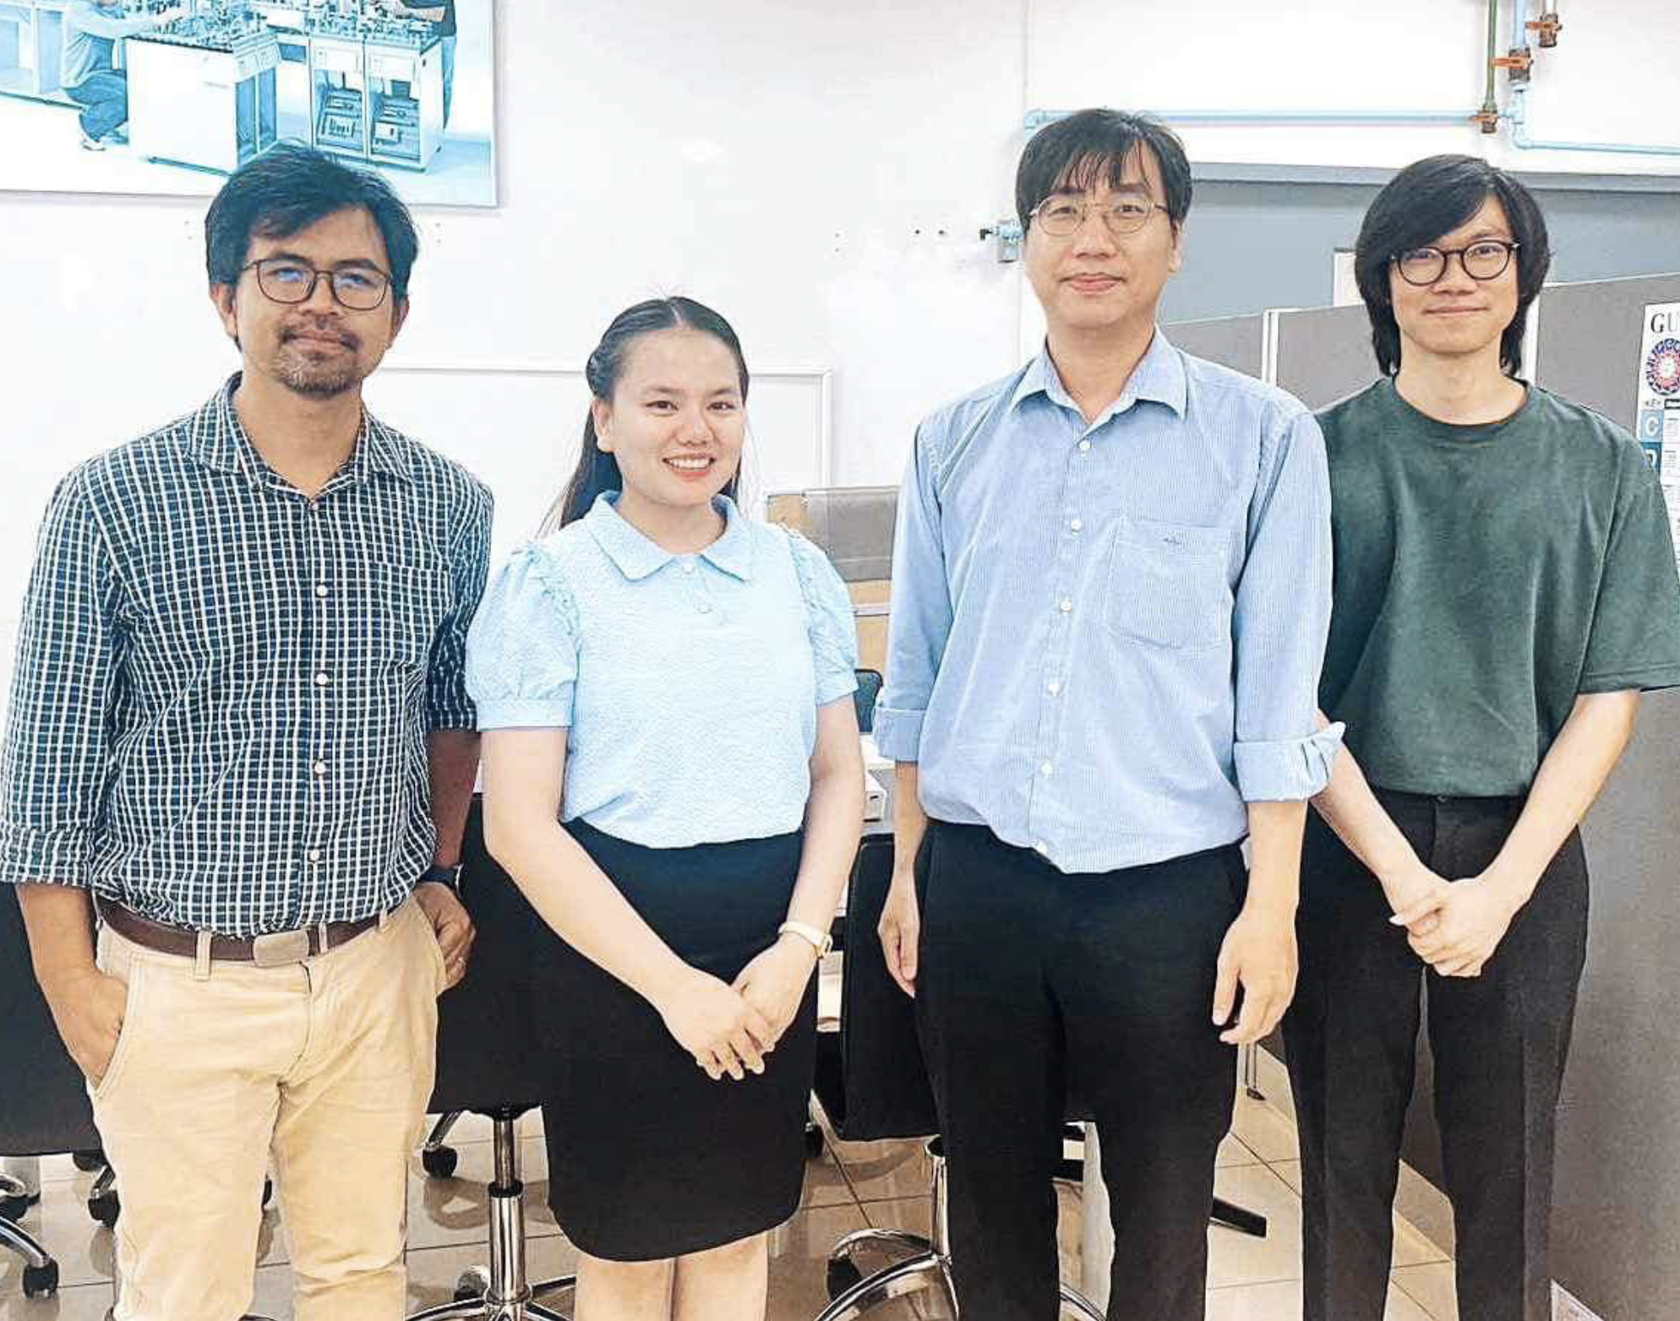
Hope and Future — Educating the Next Generation of Scientists

Slide 16
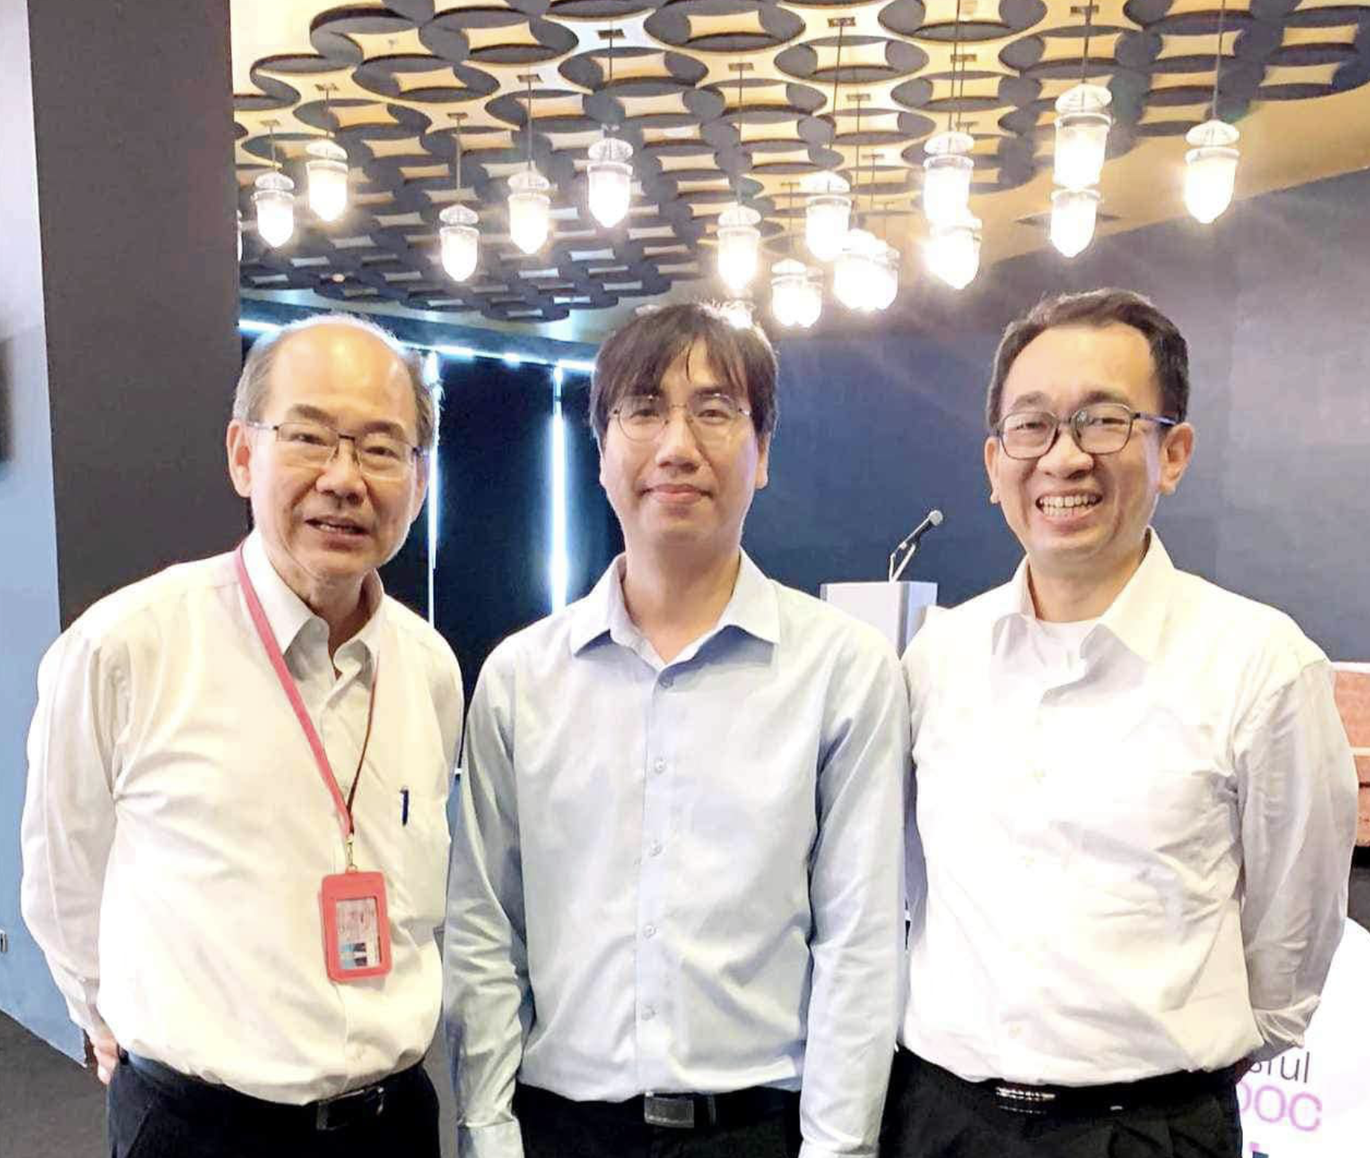
An Invitation to Become a Faculty Member at Chulalongkorn University

Slide 17
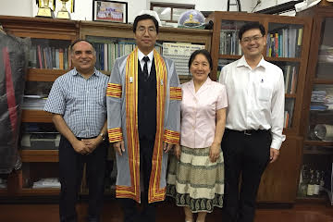
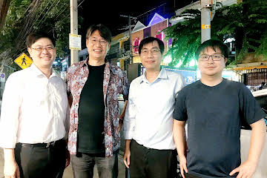

Collaborations

Slide 18
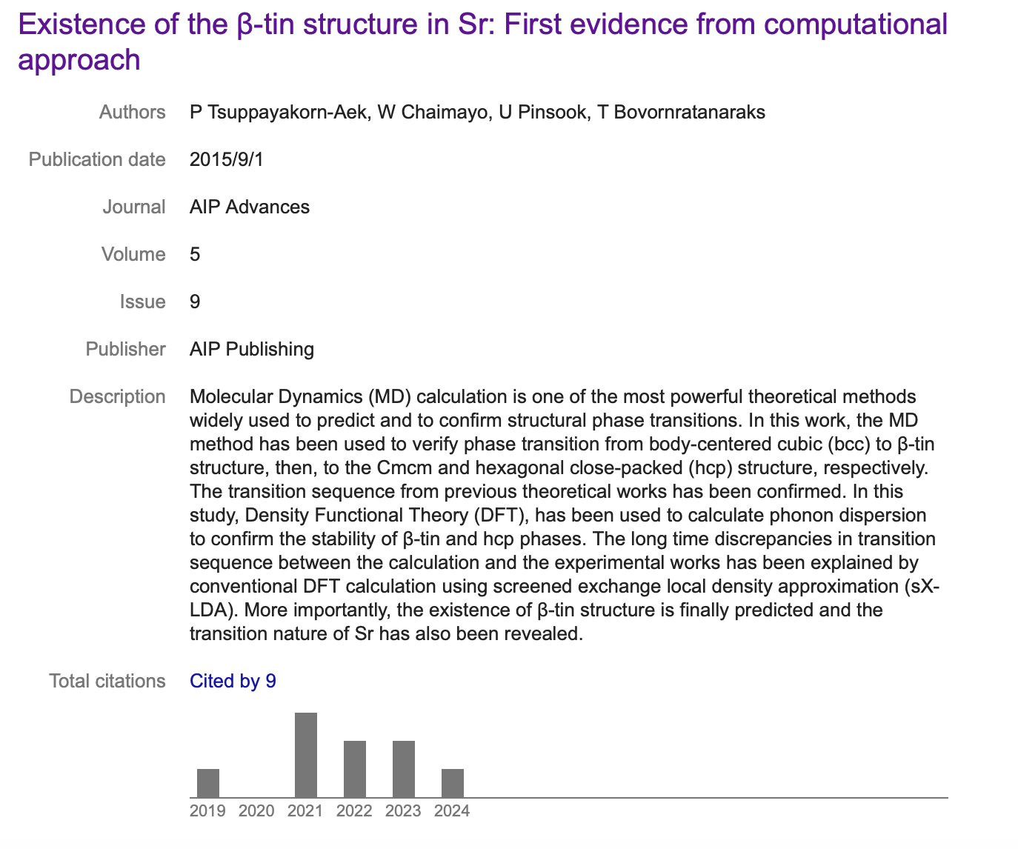
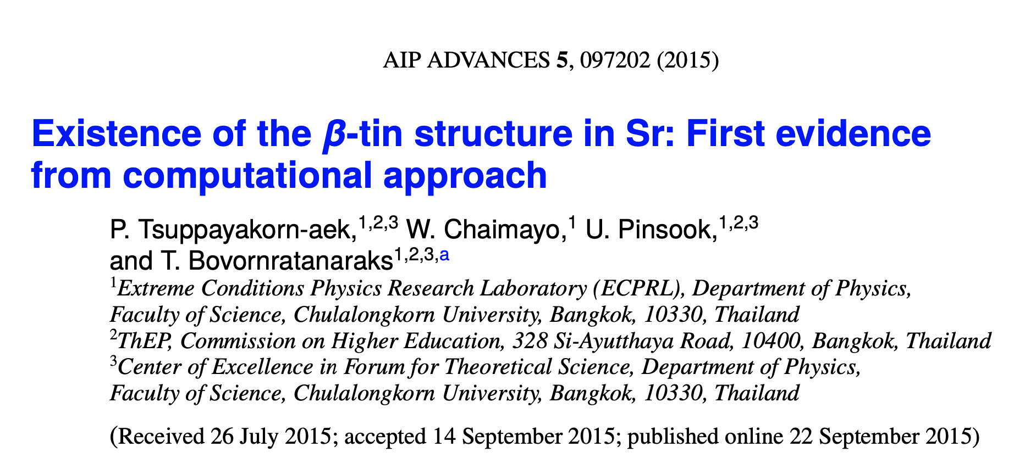
First publication
Cambridge Serial Total Energy Package (CASTEP).
This paper has been rejected by about 10 journals!
I have come to realize that the first paper is not really easy for a first research attempt.
However, I would like to say that we can learn from failure and setbacks. This experience helps us grow.

Slide 19
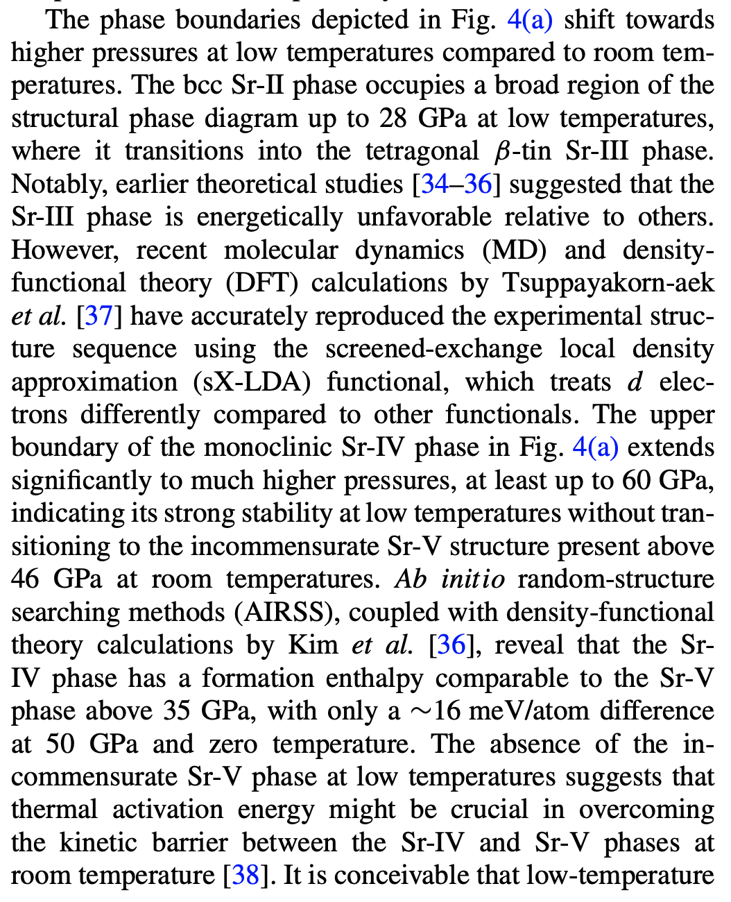
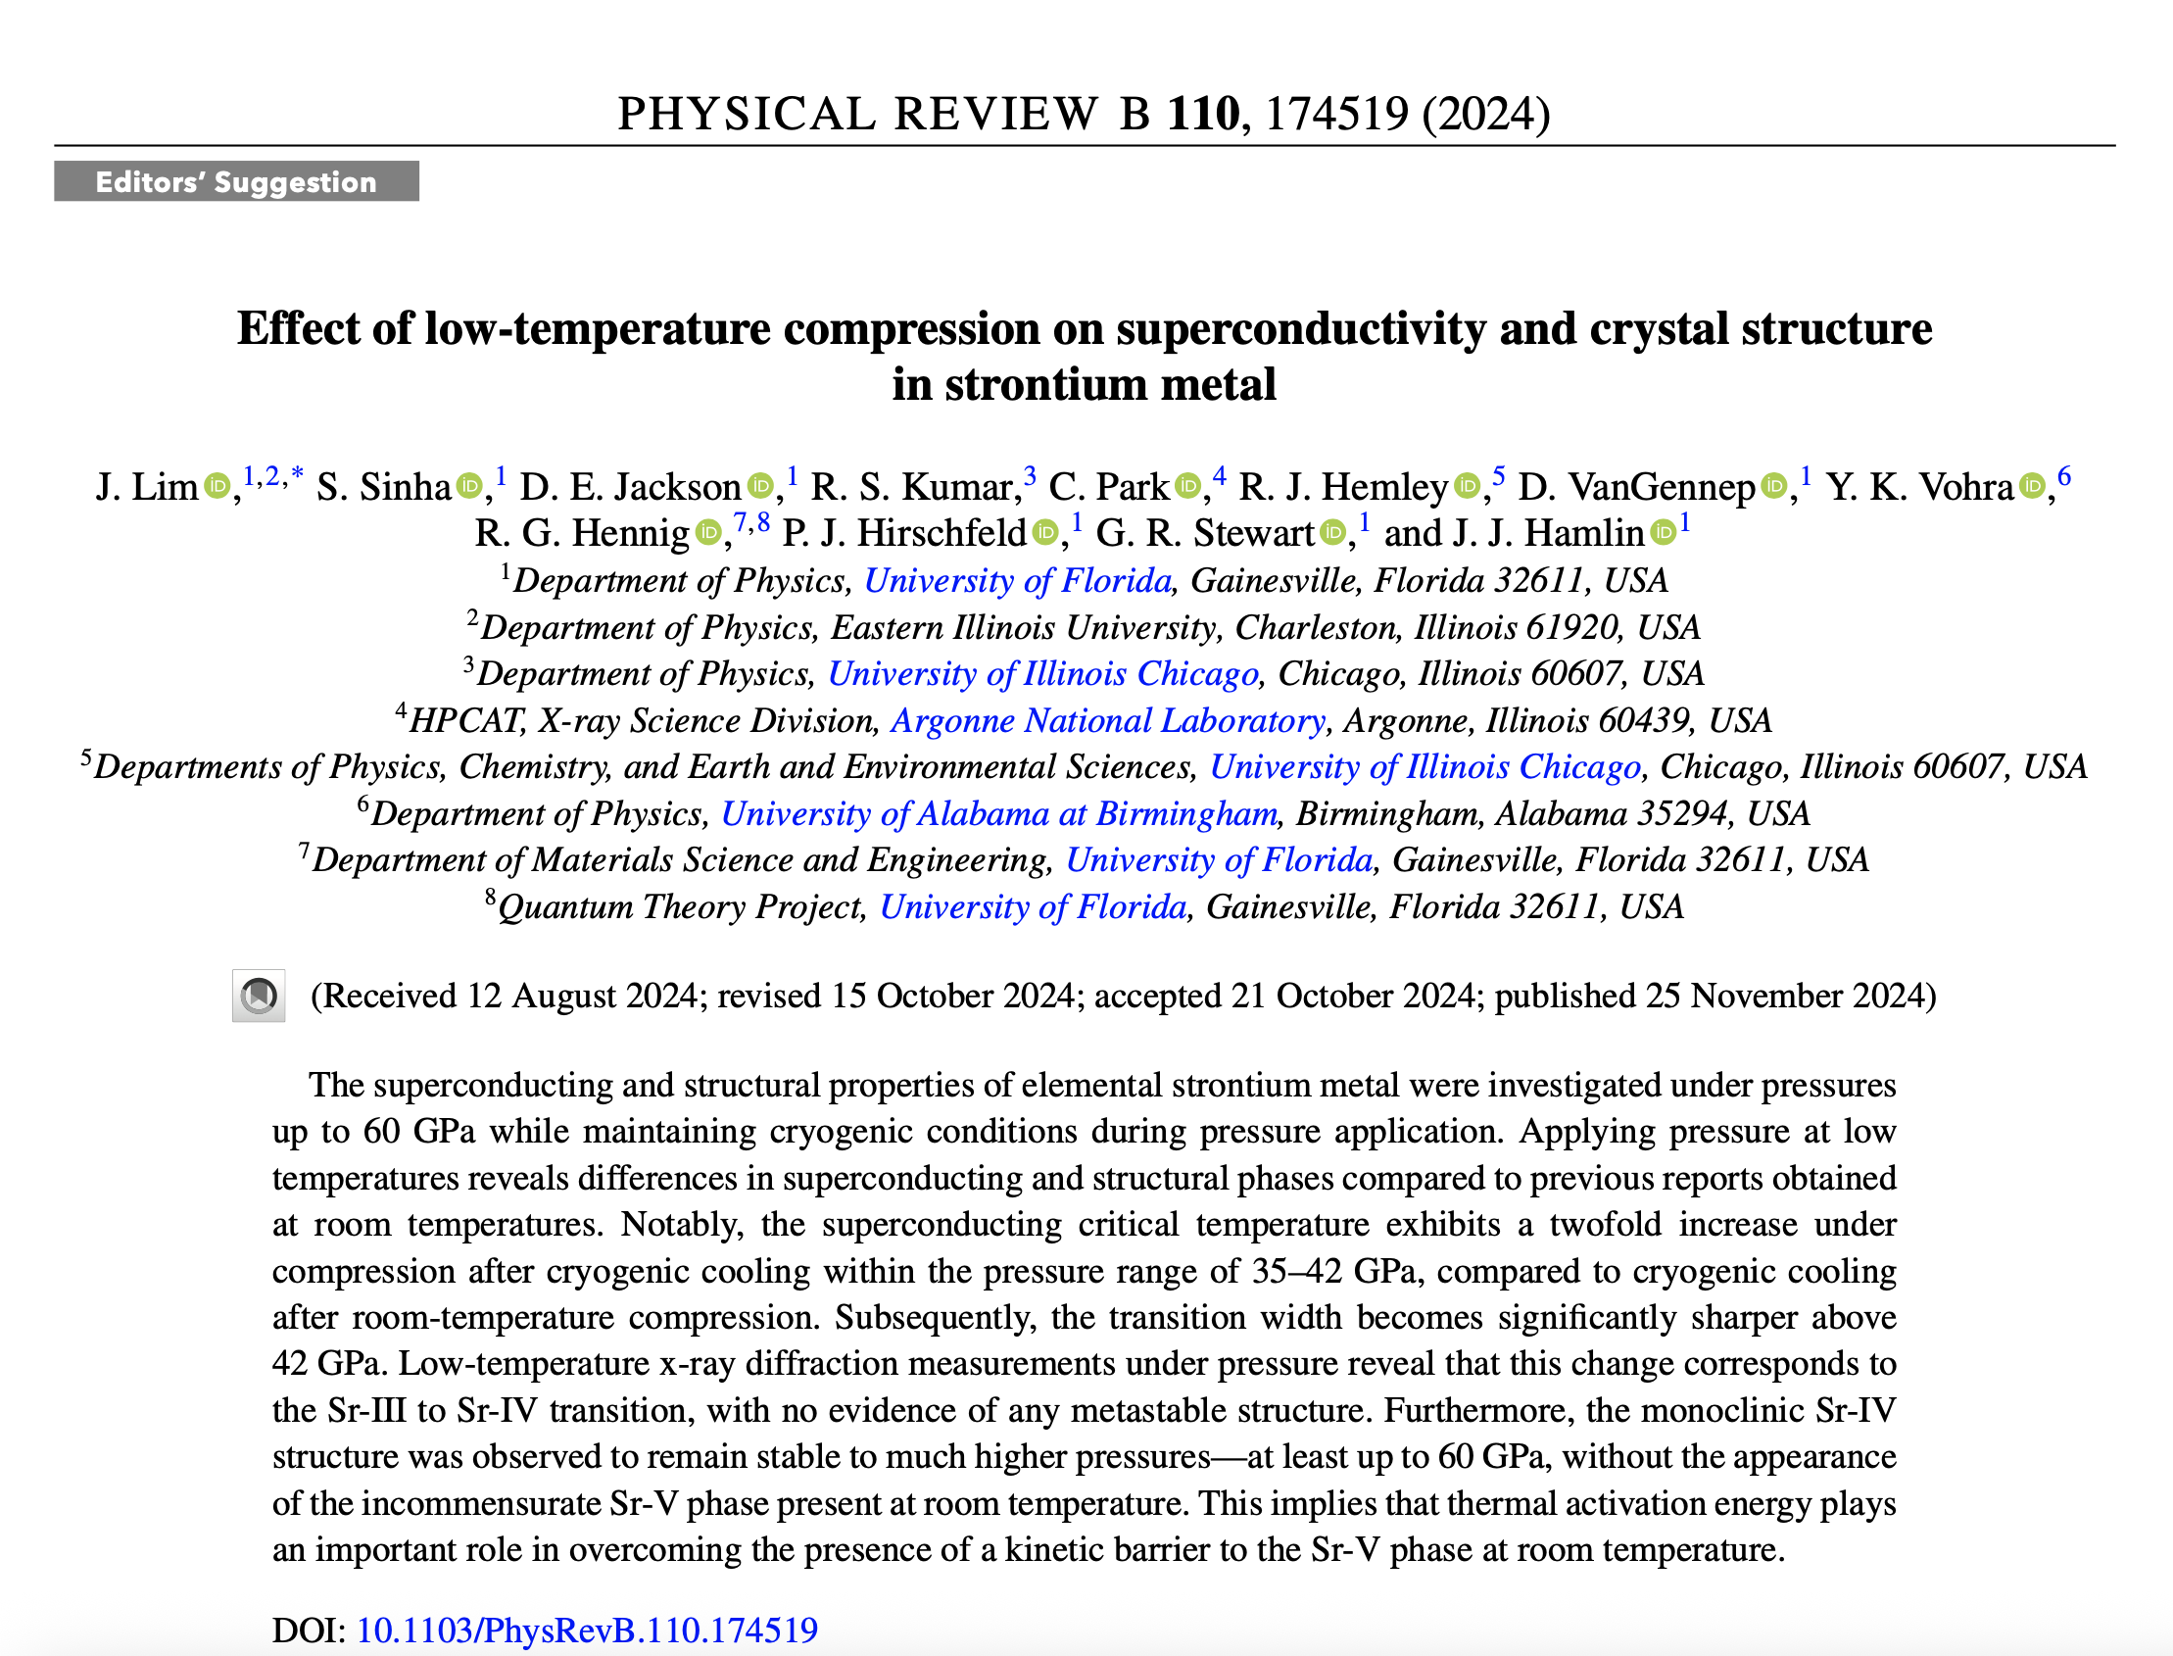

Slide 20
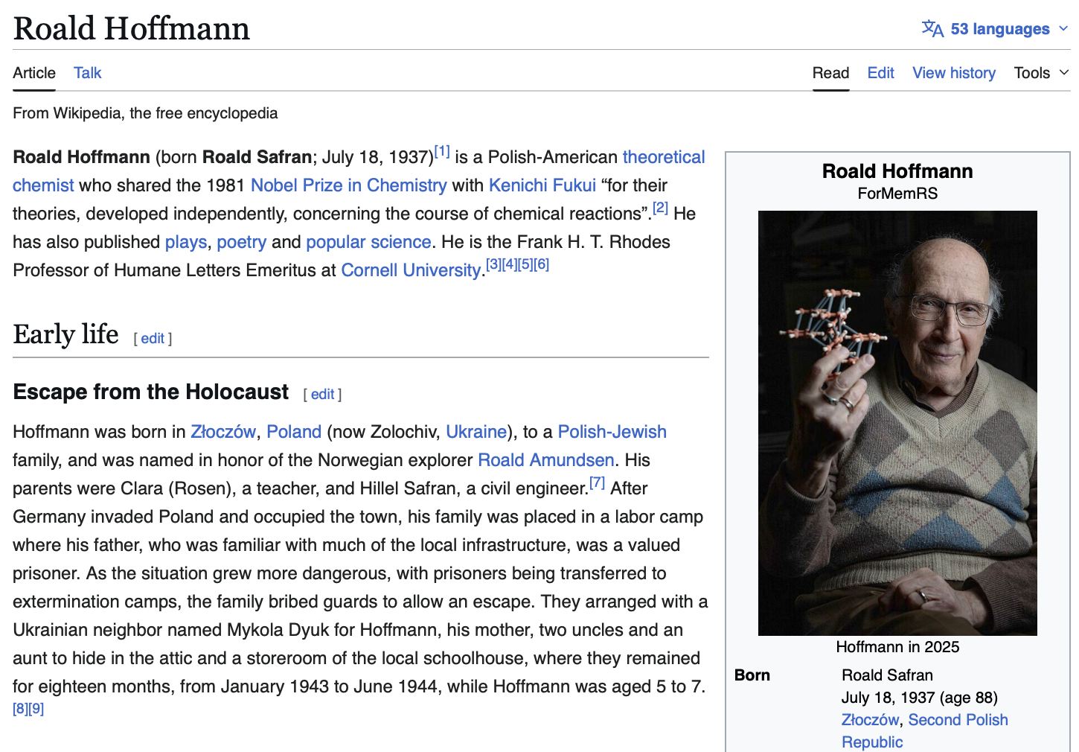


Slide 21
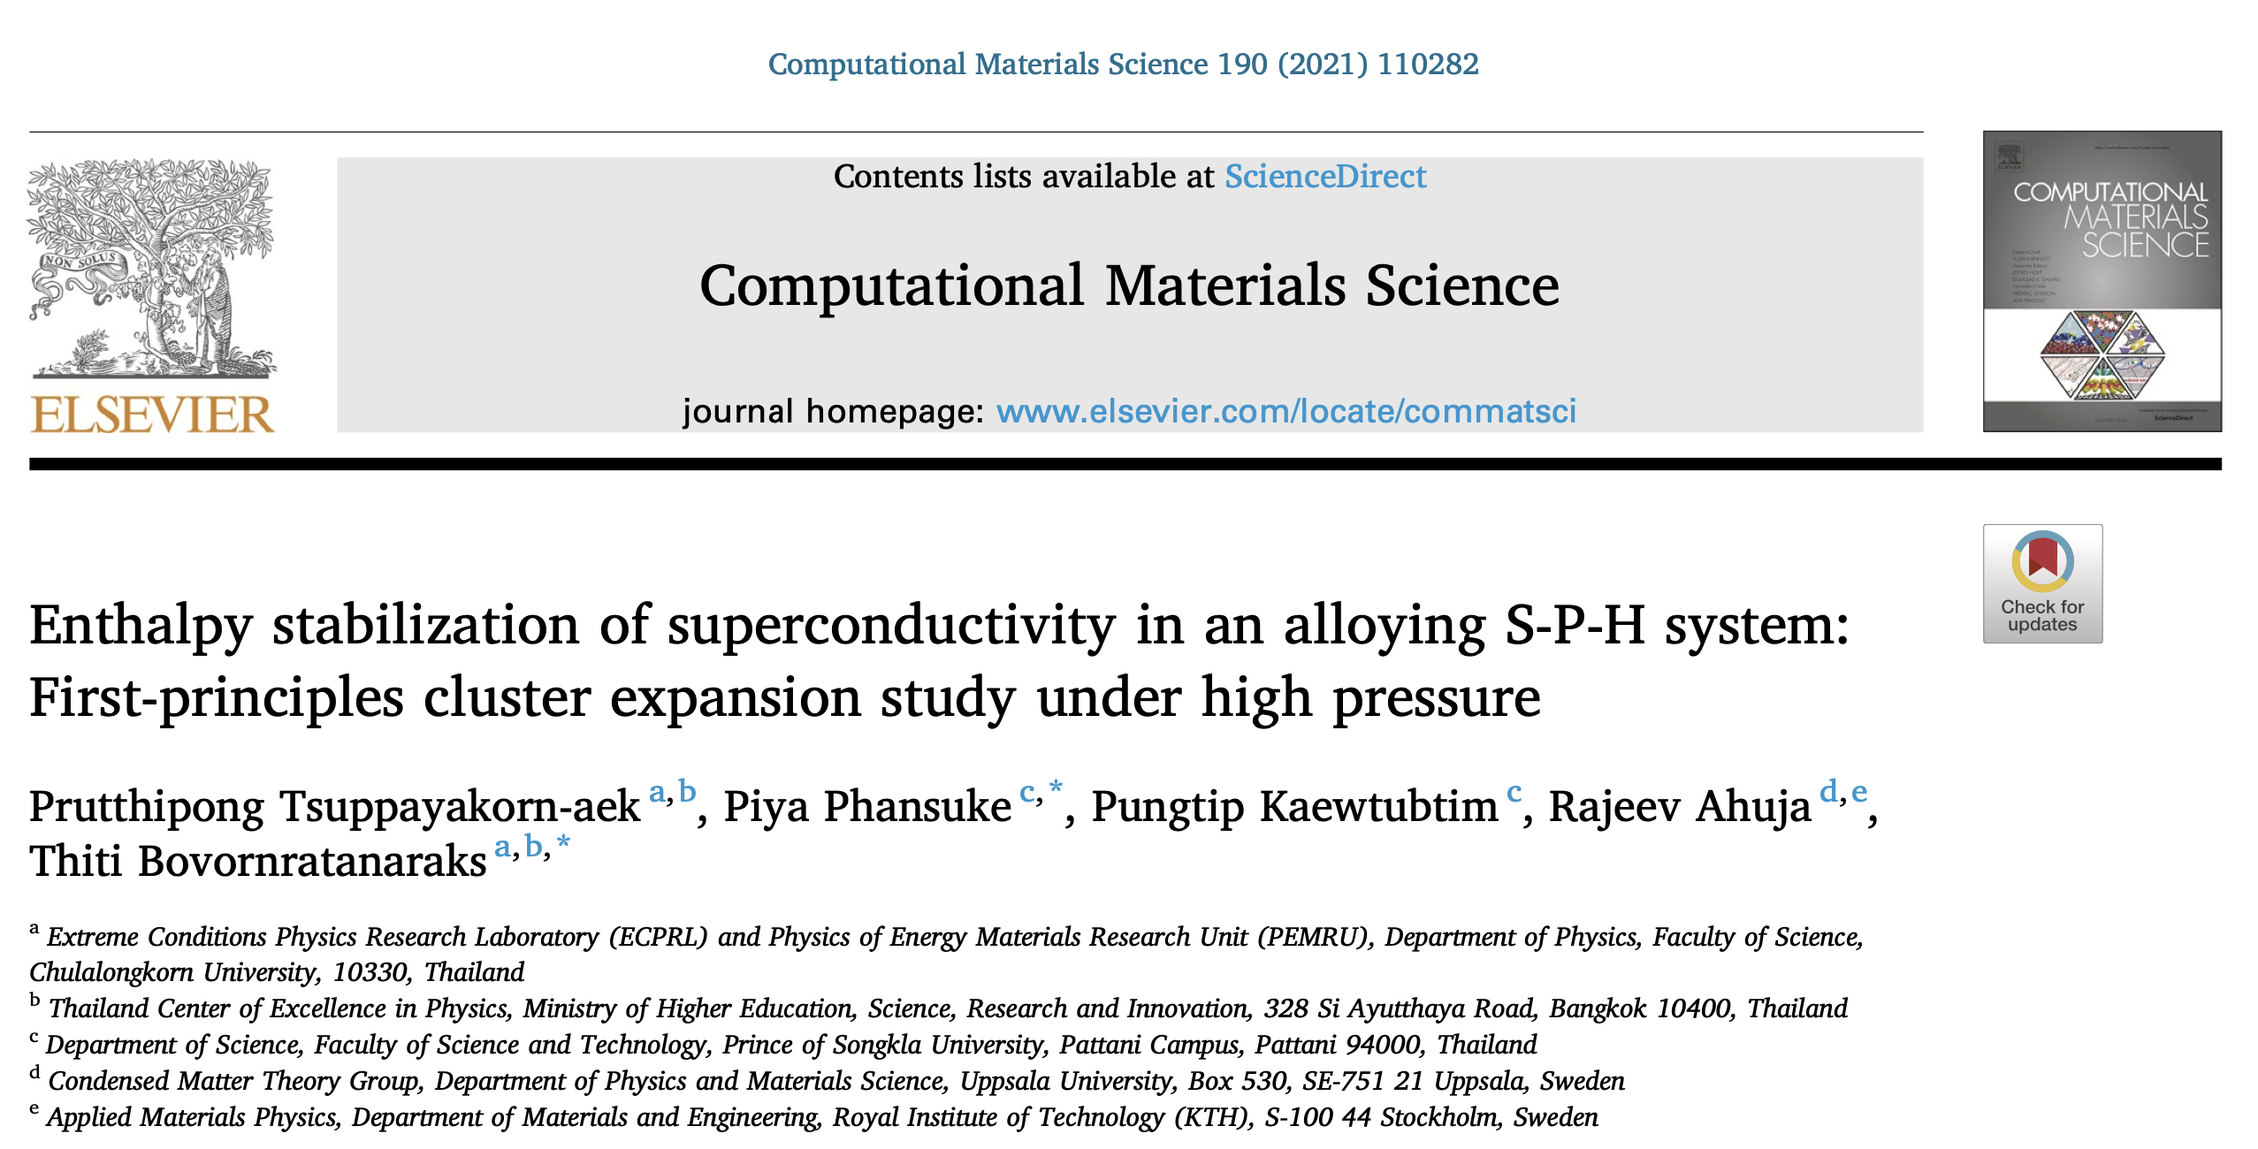
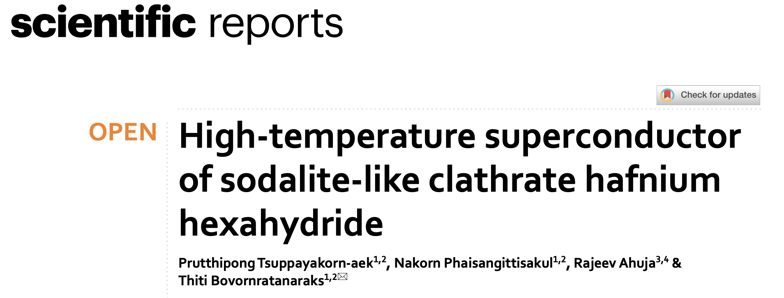
Publications by C2F Postdoc (First year; 2021)
Tier1 scopus; 24 citations
Tier1 scopus; 17 citations
In 2021, I published two papers as the first author for both of them.

Slide 22
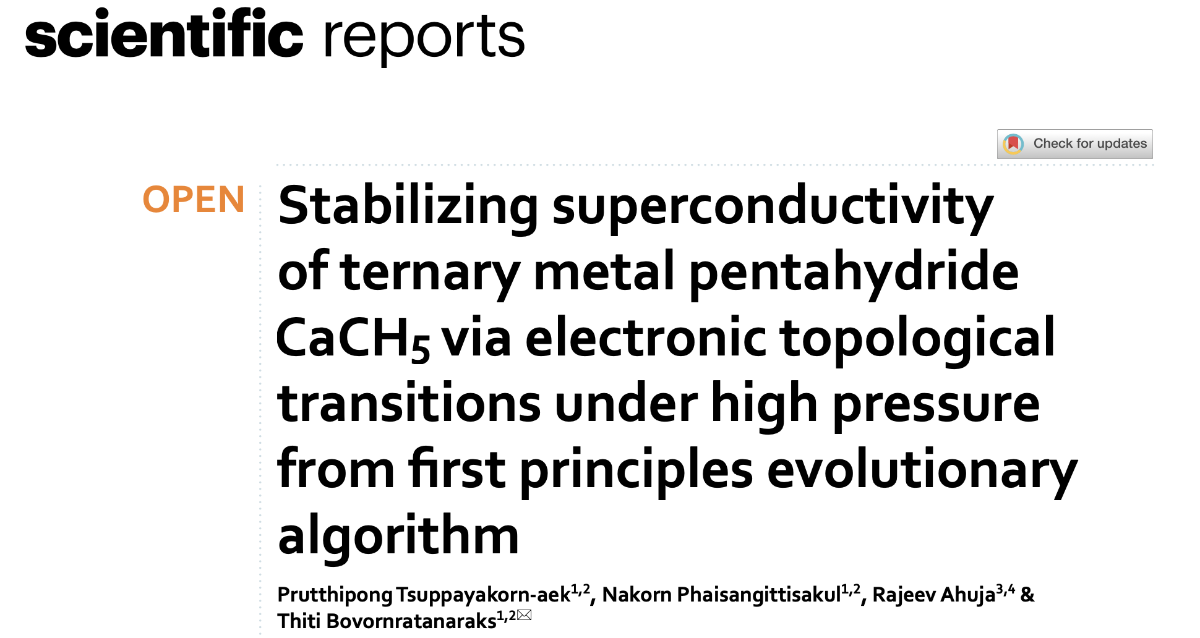
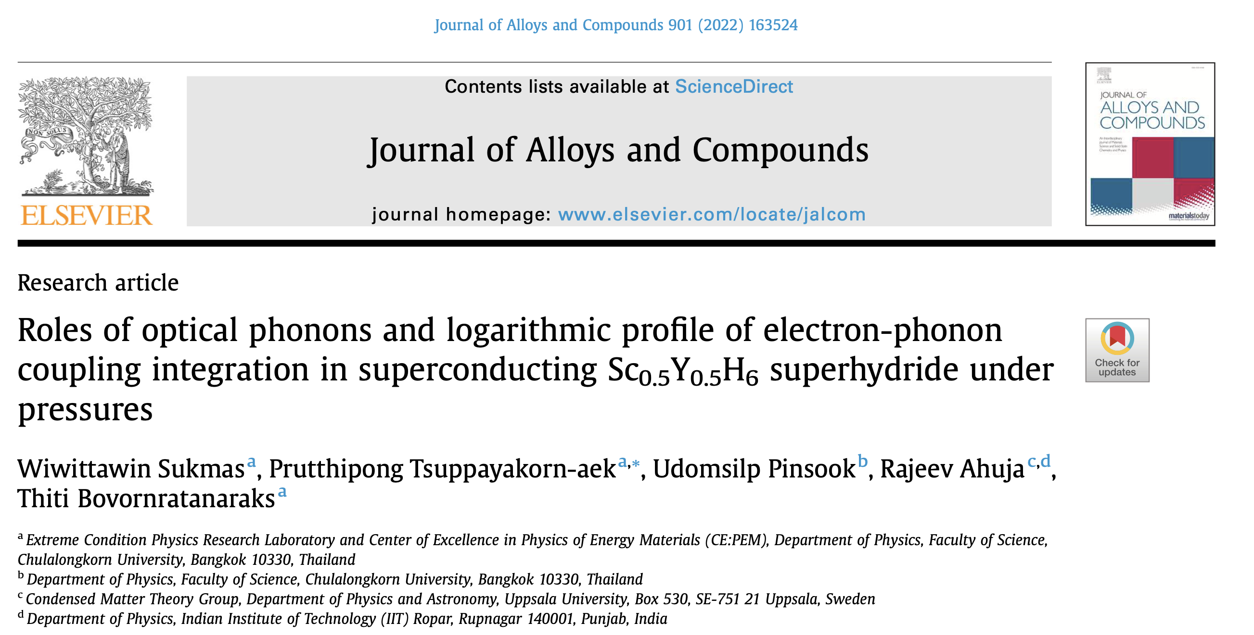
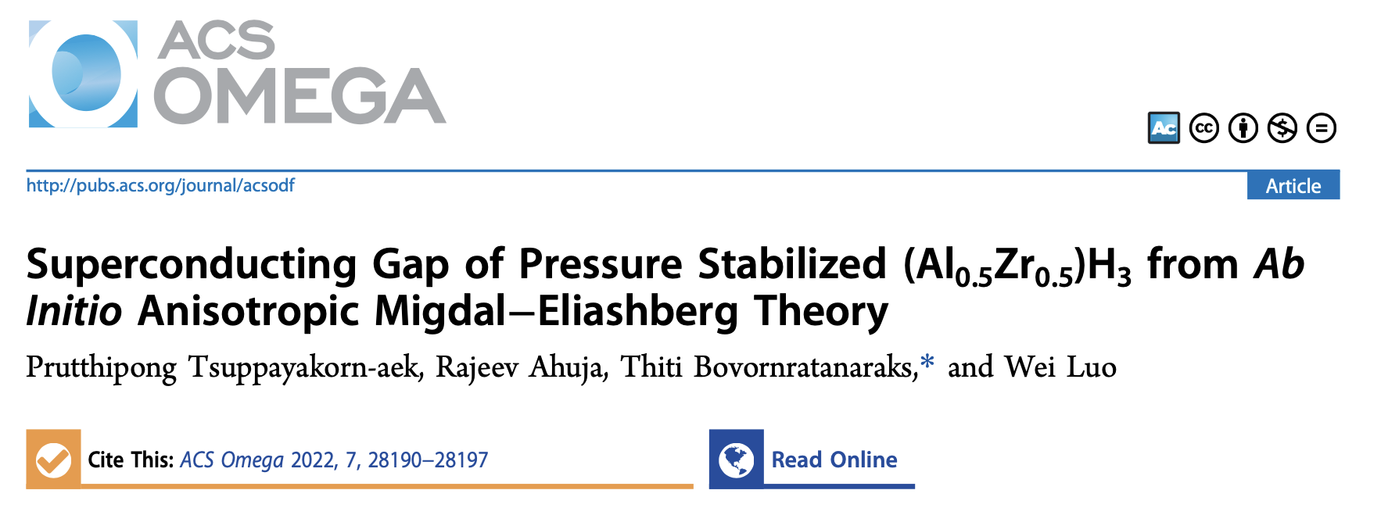
Publications by C2F Postdoc (Second year; 2022)
Tier1 scopus; 4 citations
Tier1 scopus; 11 citations
Q1 scopus; 4 citations
In 2022, I published three papers as the first and
corresponding author for all of them

Slide 23
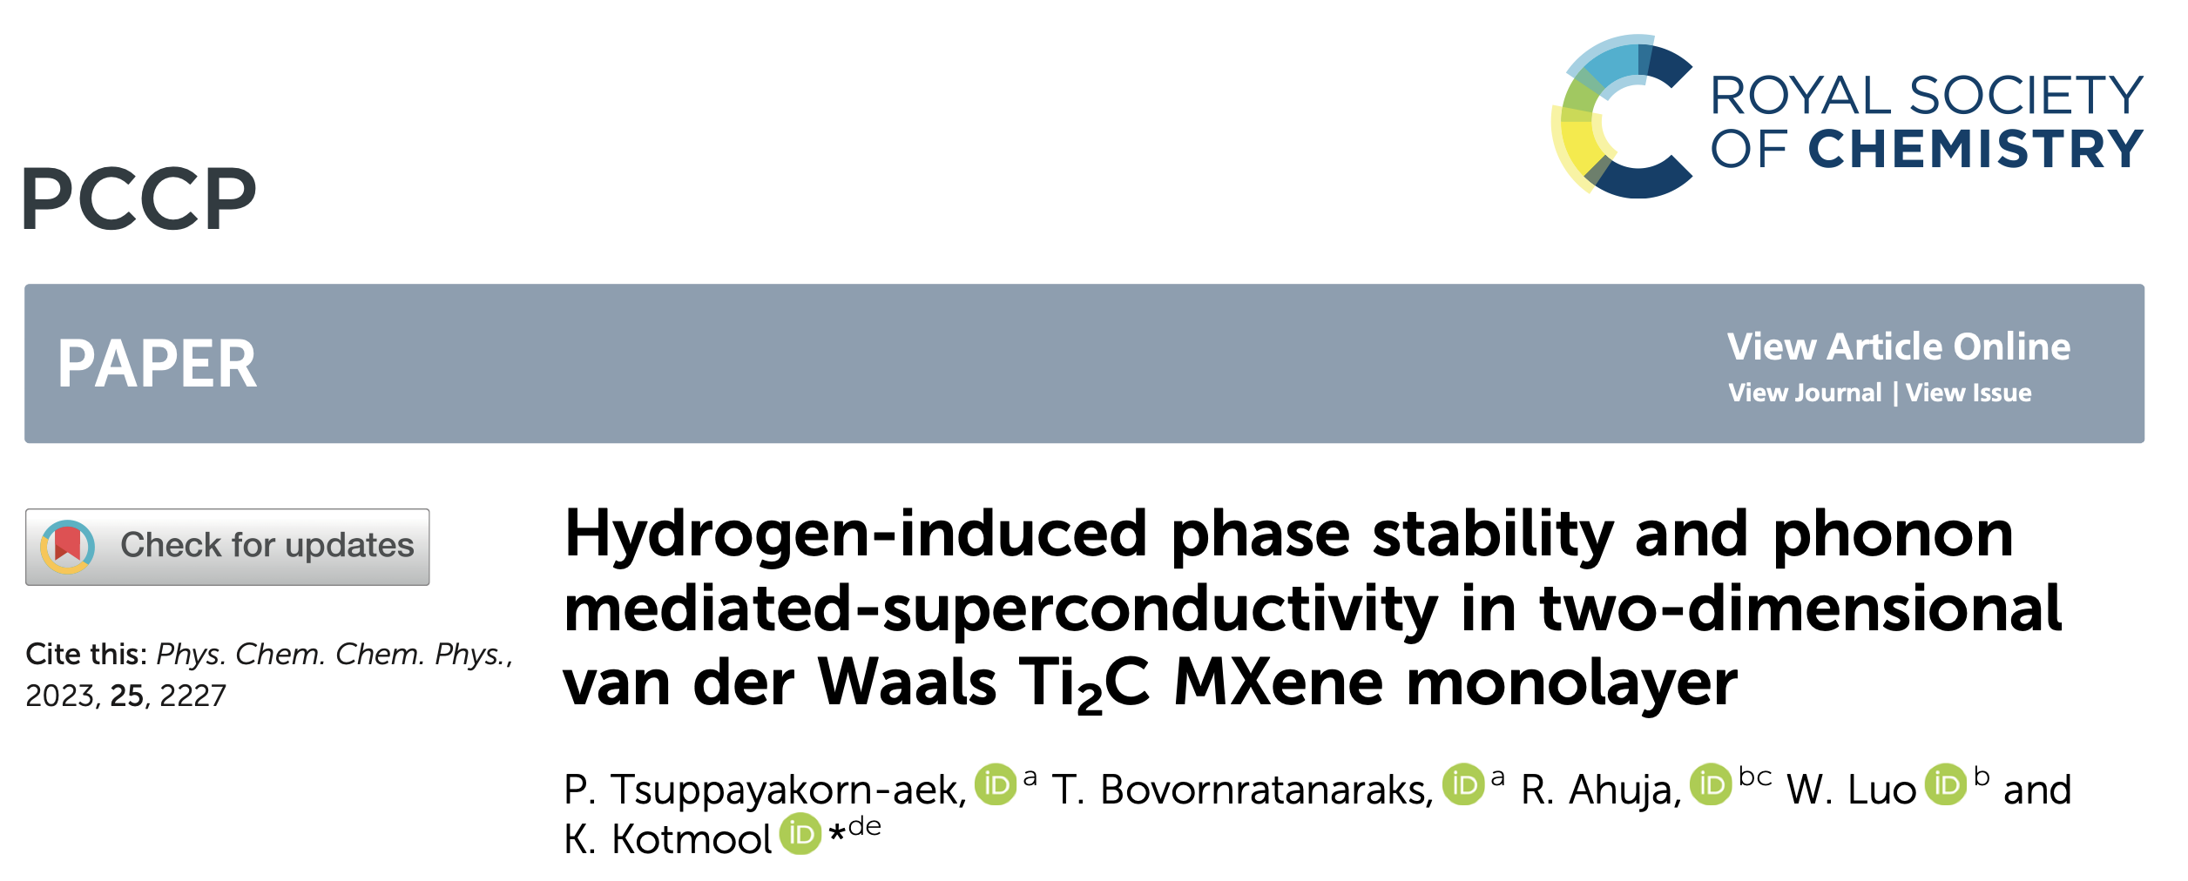
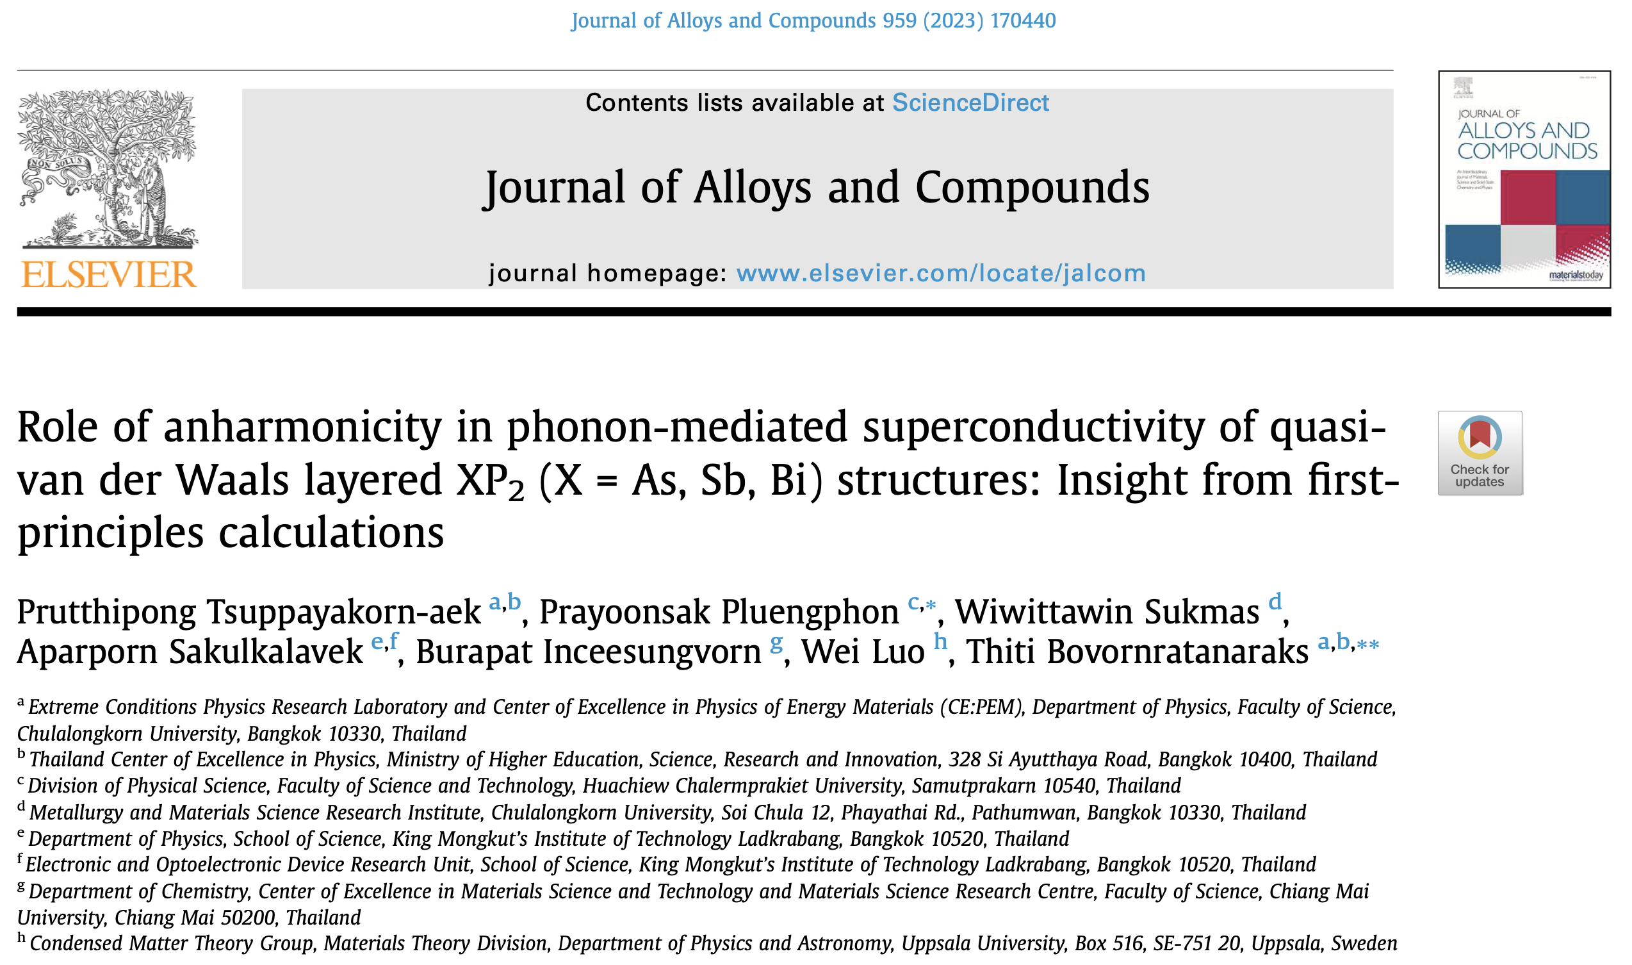
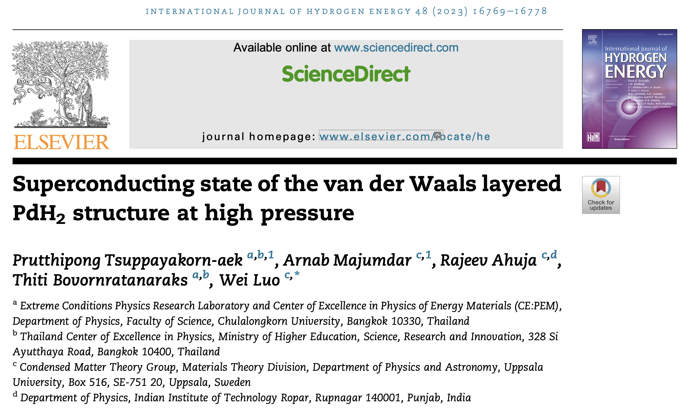
Publications by C2F Postdoc (Third year; 2023)
Q1 scopus; 3 citations
Tier1 scopus; 1 citation
Tire1 scopus; 5 citation
In 2023, I published three papers as the first for all of them

Slide 24
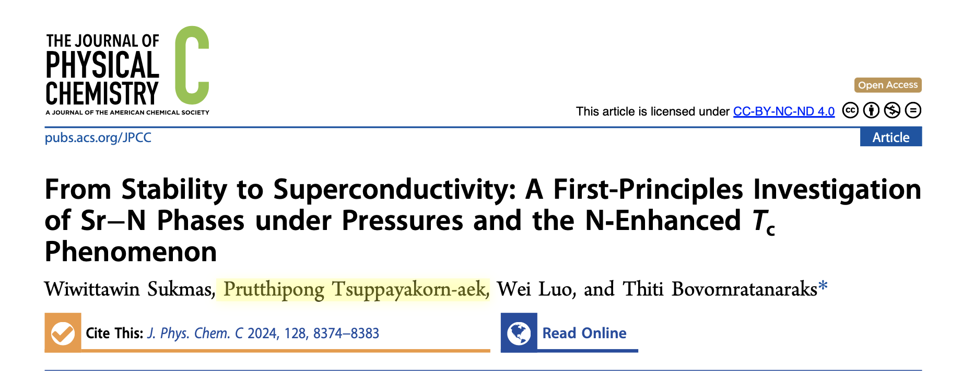
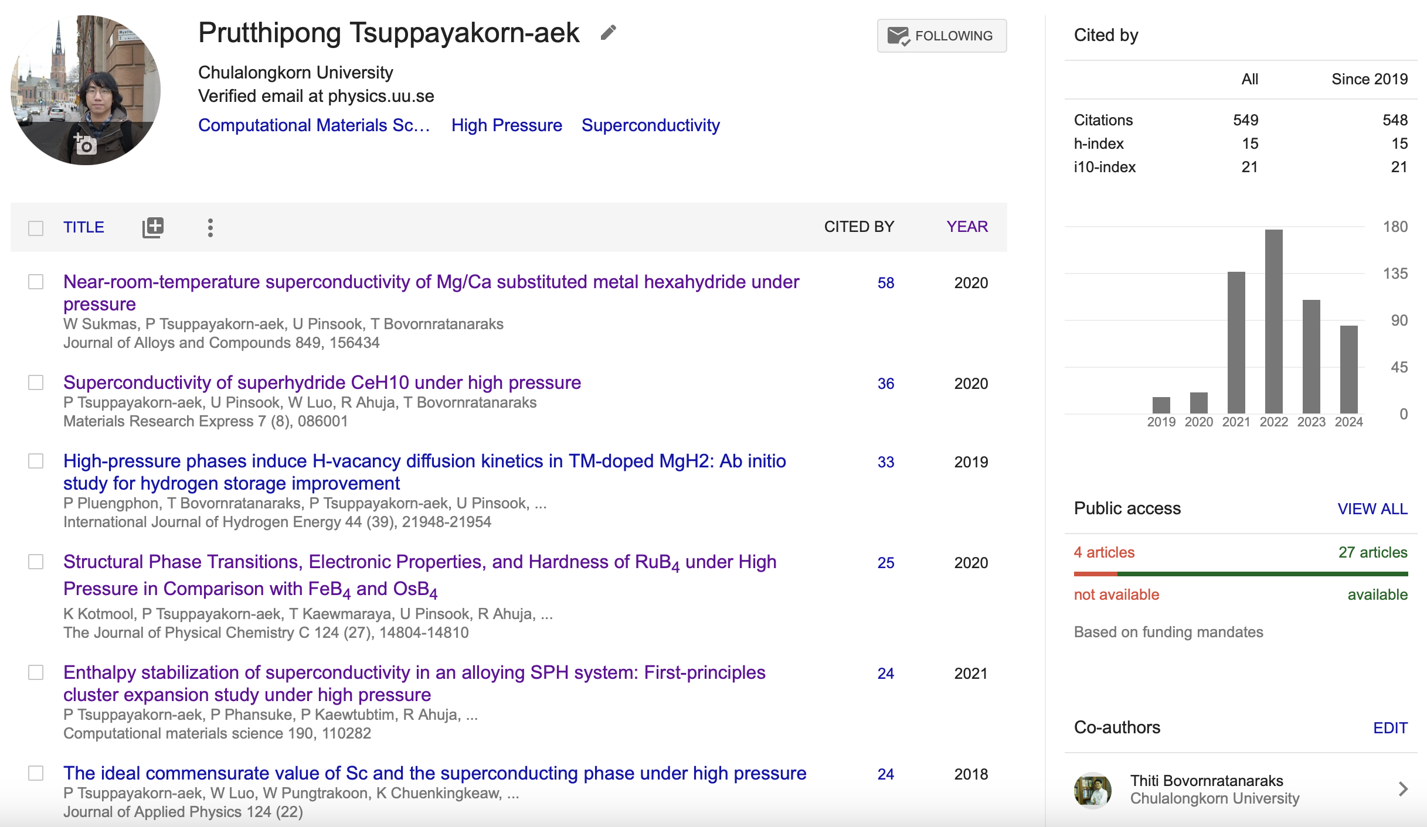
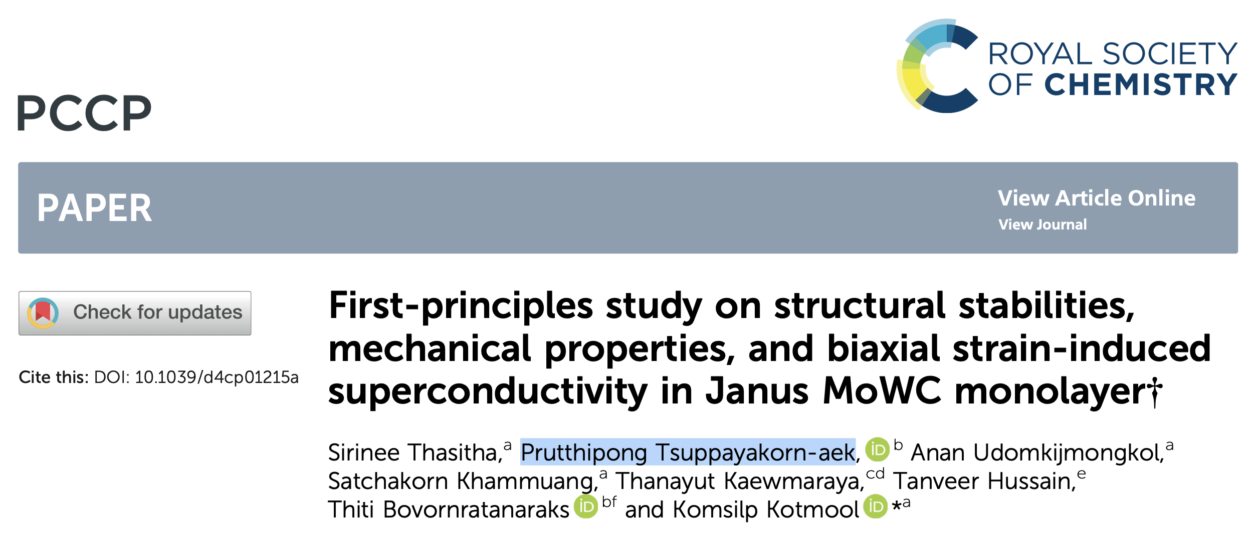
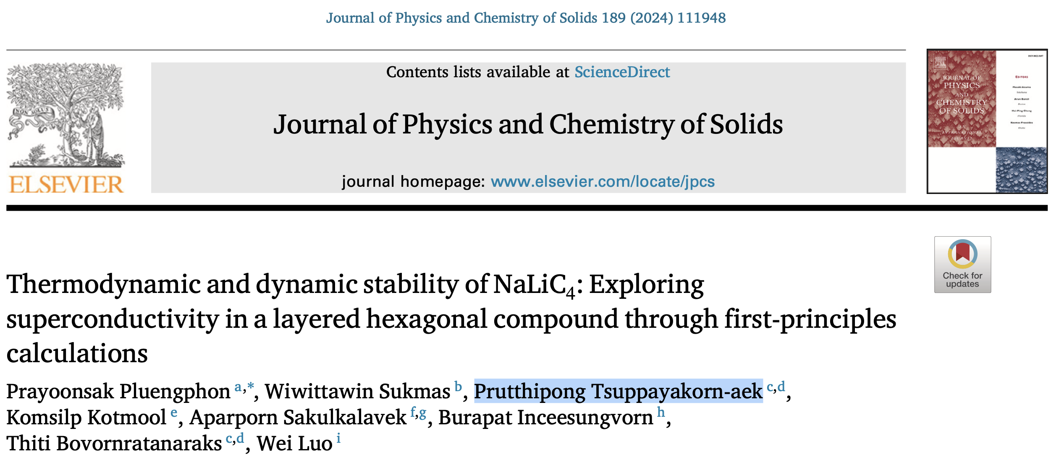
Publications in 2024
Fourth year (Q1 scopus in 2024)
Fourth year (Q1 scopus in 2024)
Fourth year (Q1 scopus in 2024)
In 2024, I published three papers as the co-author for all of them

Slide 25
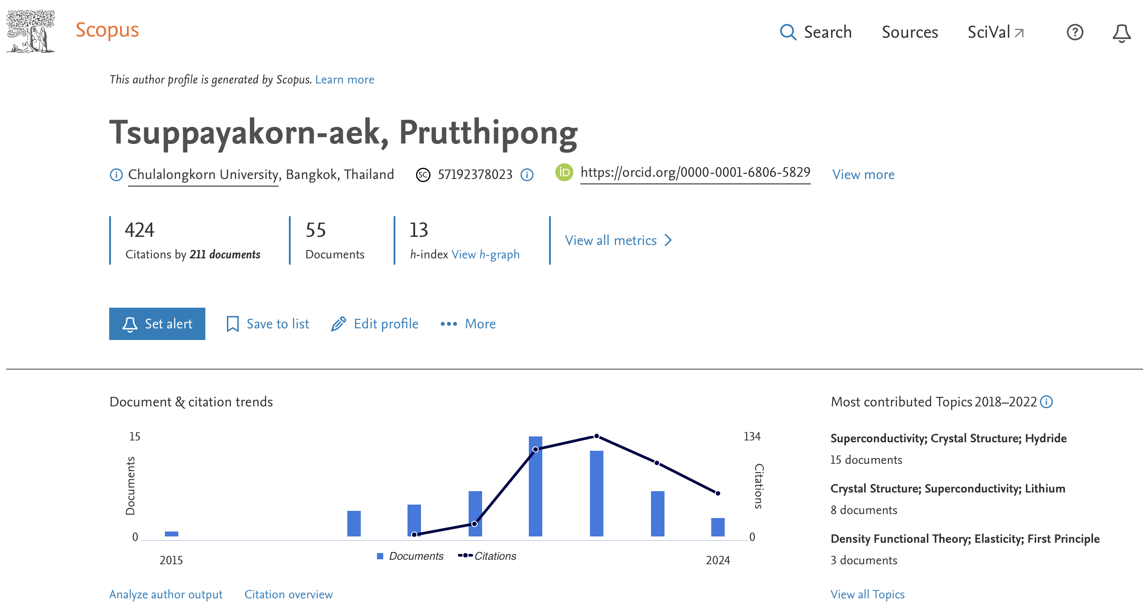


Publication by C2F Postdoc
This is my 56th publication (Tire1 scopus in 2024)

Slide 26


Slide 27
Referee
Journal of Applied Physics (American Institute of Physics)
Journal of Physics: Condensed Matter (IOPscience)
Superconductor Science and Technology (IOPscience)
Physica Scripta (IOPscience)
The European Physical Journal B (SpringerLink)
Journal of Molecular Modeling (SpringerLink)
Energy Advances (Royal Society of Chemistry)

Slide 28
Bridging Research
Research Skills: Mastery of analytical thinking, data interpretation, and problem-solving is crucial for effective research.
Collaborative Approach: Partnering with diverse experts facilitates overcoming skill deficiencies and accelerates problem-solving.
Key Takeaway: Emphasizing the importance of skill diversity and collaboration in enhancing research outcomes.
Goal: Preparation of more than 3 manuscripts for submission as the first author. However, having one manuscript does not always guarantee acceptance for publication
.Acknowledgements:
- Thanks to C2F (This research project is supported by the Second Century Fund (C2F), Chulalongkorn University, Thailand. )

Slide 29





Slide 30
Thank you for your attention

